Slide 1
TrustedCI NSF Cybersecurity Summit 2018
Compliance 101: HIPAA, FISMA, NIST 800-171 and GDPR
FISMA
Susan Ramsey, NCAR Security Engineer

Slide 2
STRETCH!! Next Hour Covers:
What is FISMA?
RMF in a nutshell
What are the intangible or unexpected costs?
Based on our experience, mileage may vary
How to leverage or translate existing frameworks and resources
Don’t fear, deconstruct, and WWRRD

Slide 3
What is FISMA
2002 - Federal Information Security Management Act
2014 - Federal Information Security Modernization Act
Requires Federal Agencies to strengthen information security
Requires annual assessments and grade reports handled by Office of Management and Budget
Intended to be managed in a cost-effective, timely and efficient manner
Relies on NIST Special Publications - NIST RMF is the starting point for adoption
Notes:
https://www.sans.org/media/score/fisma-nist.pdf
https://www.dhs.gov/fisma

Slide 4
FISMA Scope
Federal Agencies
Federal Contractors
Baseline expectations specified in the contract
Open Science is not required to adopt NIST
NSF does not require a NIST-based SSP
“Low” baselines do not require external audit
Neither does CUI/800-171
Notes:
https://www.dhs.gov/publication/fy18-fisma-documents
https://csrc.nist.gov/publications/detail/sp/800-60/vol-1-rev-1/final

Slide 5
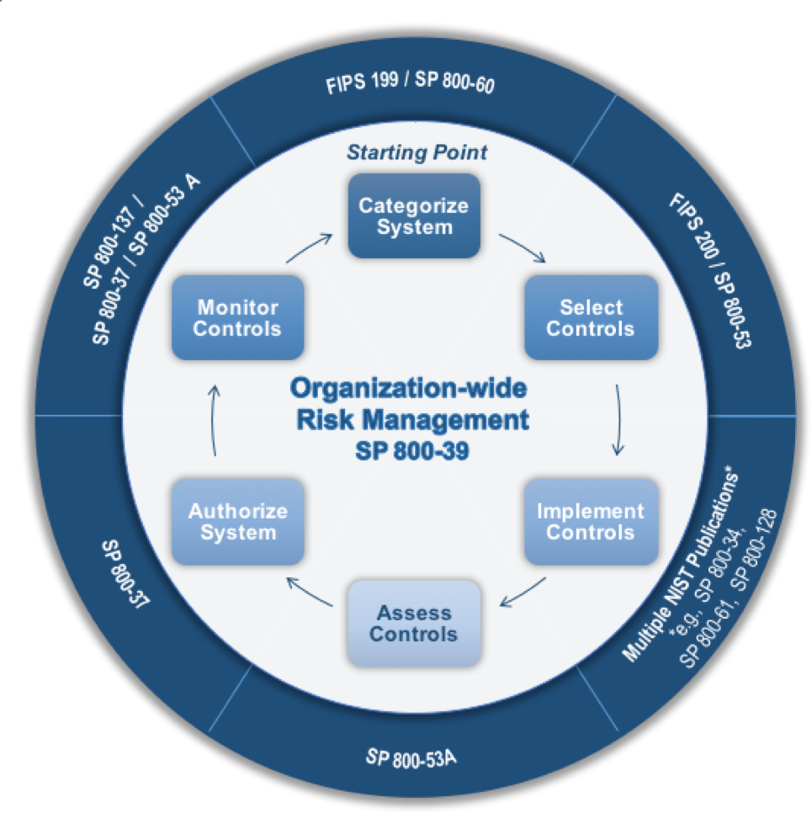
Risk Management Framework

Slide 6
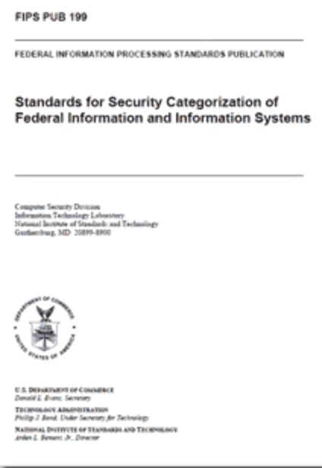
Step 1: Categorize Information System
NIST Publications: FIPS-199, SP 800-60v1&v2
Hosts, Switches, SANS, Cloud Objects, IOTs (satellites, microscopes, ground stations)
VM Templates, Types of Ephemeral Instances, Containers
Data
Dataflows (diagrams)
Network flows (diagrams)
ISAs - may take additional time with multi-agency approvals
Roles and Responsibilities - make sure whomever needs to sign is often available to sign
Approved software
Expected open ports
Give it a short, specific, name - don’t change the name arbitrarily
Classification of data or service
Notes:
https://nvlpubs.nist.gov/nistpubs/FIPS/NIST.FIPS.199.pdf for federal systems and agencies
https://nvlpubs.nist.gov/nistpubs/FIPS/NIST.FIPS.200.pdf specifies the minimum security requirements for non-military federal information systems

Slide 7
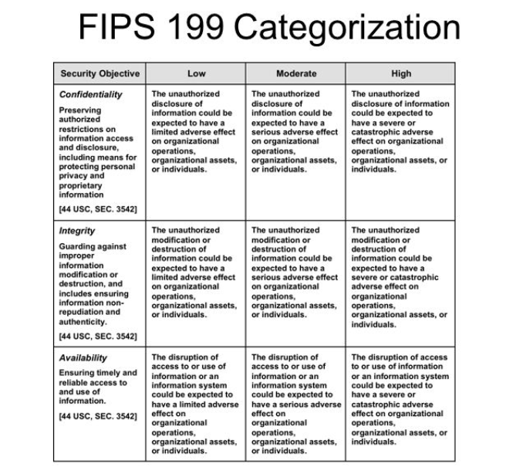
Confidentiality
Integrity
Availability
Low
Moderate
High

Slide 8
NIST 800-60 v2r1 D.19.1
General Sciences and Innovation
D.19 General Sciences and Innovation General Science and Innovation includes all Federal activities to meet the national need to advance knowledge in this area. This includes general research and technology programs, space exploration activities, and other research and technology programs that have diverse goals and cannot be readily classified into another mission area or information type.
D.19.1 Scientific and Technological Research and Innovation Information Type Scientific and Technological Research and Innovation includes all federal activities whose goal is the creation of new scientific and/or technological knowledge as a goal in itself, without a specific link to the other mission areas or information types identified in the BRM. Most sensitive information is developed under research and development programs that directly support another of the mission areas described in this Appendix and are not included here. Some information associated with scientific and technical research and innovation is national security information and is outside the scope of this guideline. The recommended provisional categorization for the scientific and technical research and innovation information type follows:
Security Category = {(confidentiality, Low), (integrity, Moderate), (availability, Low)}
Notes:
https://nvlpubs.nist.gov/nistpubs/Legacy/SP/nistspecialpublication800-60v2r1.pdf

Slide 9
Step 2: Select Security Controls
NIST Publications: FIPS-200,NIST SP 800-53
Sets of Controls by baseline
18 Control Families (19 w/ Privacy)
Tailoring goes in the FIPS-200
High
Moderate
Low
Notes:
The baseline in your contract defines these for you. Tailor out!! What is tailoring? Anurag talked about Tailoring - asset flexibility here as well but make sure it’s in your FIPS-200
System Security Plan

Slide 10
FISMA Control Families
AC -- Access Control AT -- Awareness and Training AU -- Auditing and Accountability CM -- Configuration Management CP -- Contingency Planning IA -- Identification and Authentication IR -- Incident Response MA -- Maintenance MP -- Media Protection PS -- Personnel Security | PE -- Physical Environment Protection PL -- Planning PM -- Program Management RA -- Risk Assessment CA -- Assessment/ Authorization SC -- System and Communications SI -- System and Information Integrity SA -- System and Services Acquisition PA -- Privacy

Slide 11
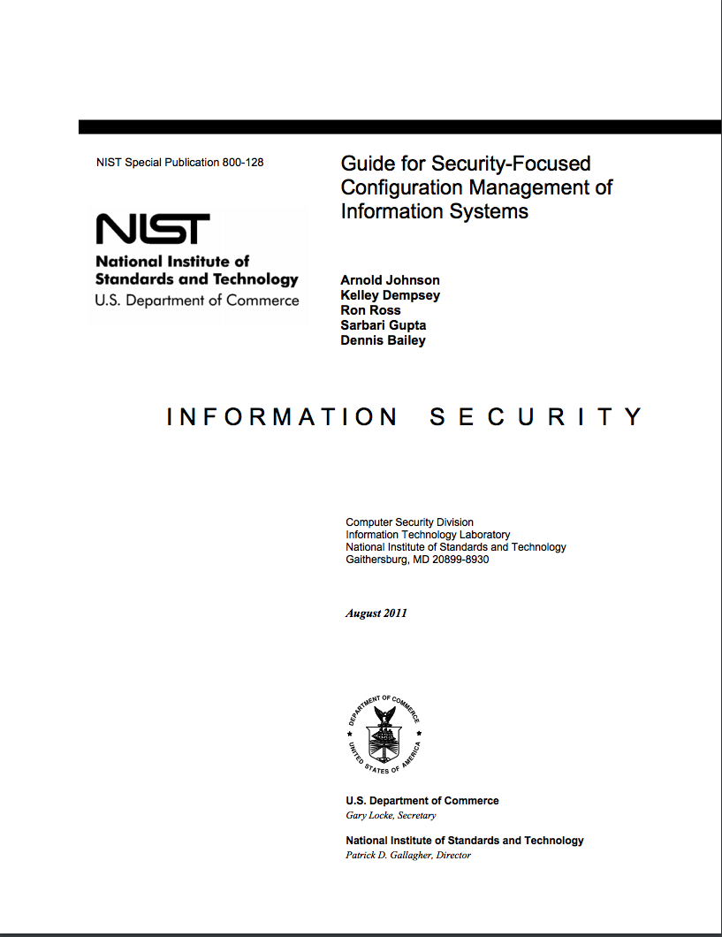
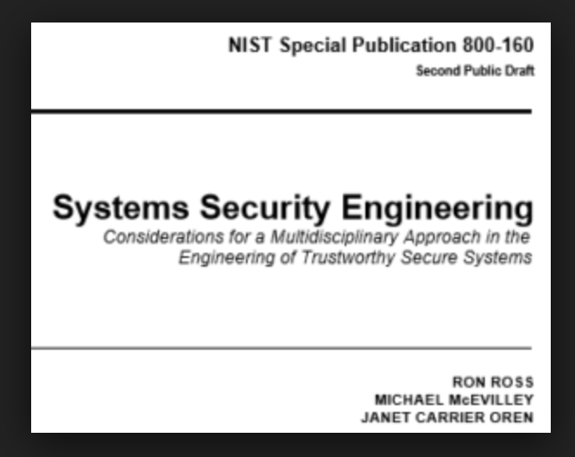
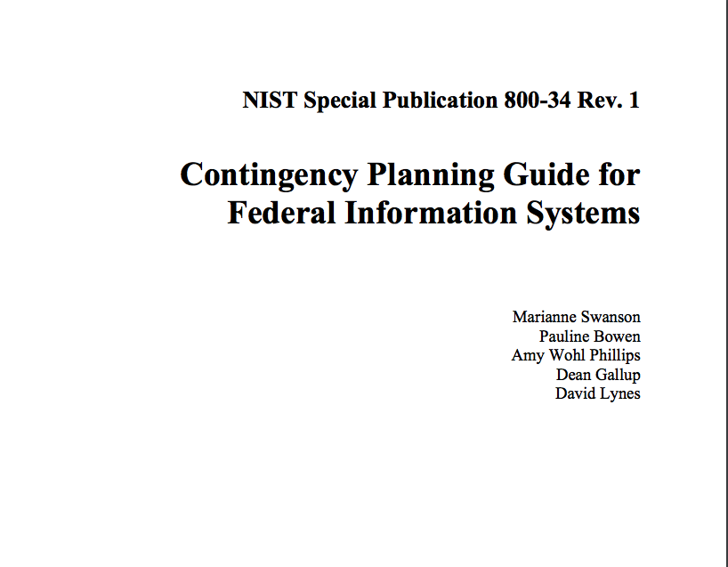
Step 3: Implement Security Controls
NIST Publications: SP 800-160, 800-128, 800-34
Notes:
https://csrc.nist.gov/publications/detail/sp/800-160/vol-2/draft
https://nvlpubs.nist.gov/nistpubs/Legacy/SP/nistspecialpublication800-128.pdf
https://nvlpubs.nist.gov/nistpubs/legacy/sp/nistspecialpublication800-34r1.pdf
Your first FISMA system requires you to establish an entire program.

Slide 12
Step 4: Assess Security Controls
NIST Publication: SP 800-53a
Internal assessment for Low
External assessment for Moderate and High
Notes:
https://nvlpubs.nist.gov/nistpubs/SpecialPublications/NIST.SP.800-53Ar4.pdf

Slide 13
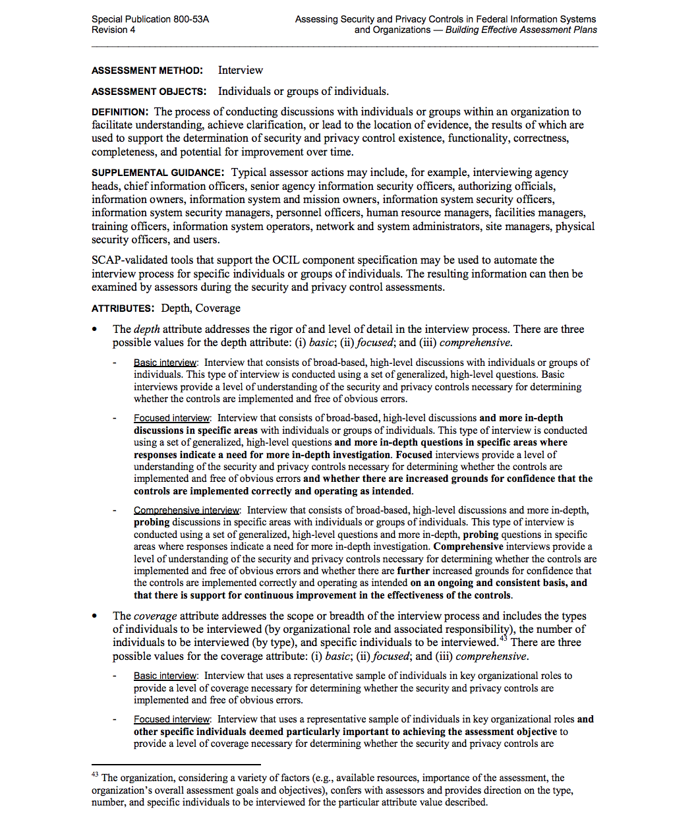
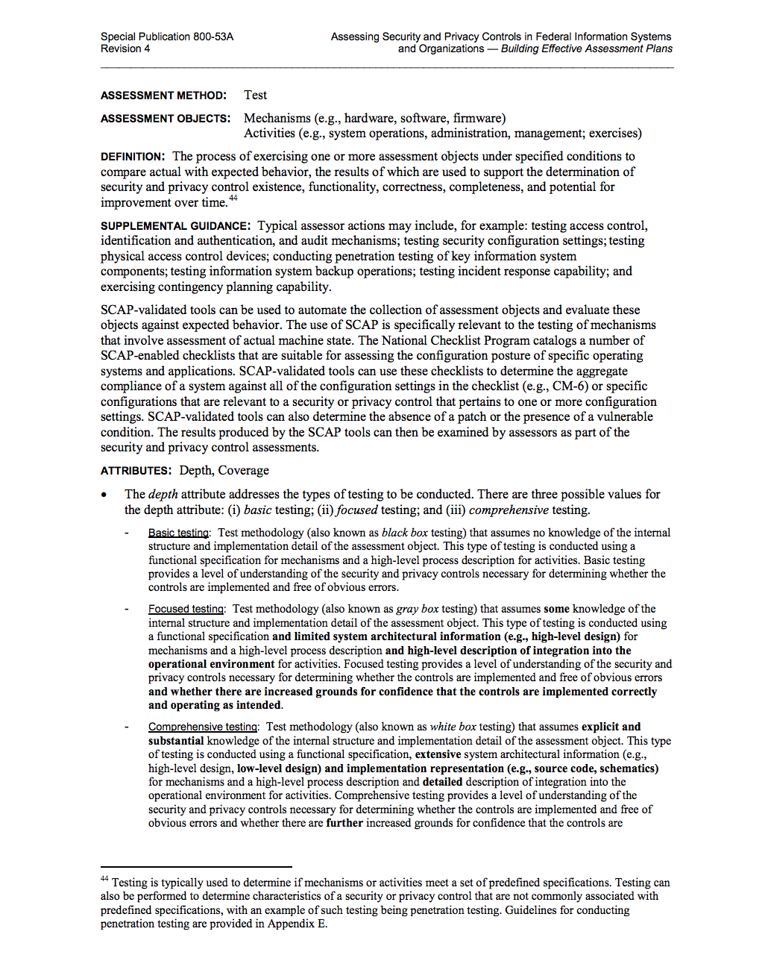
D
E
F
I
N
E
D
A
U
D
I
T
I
N
G

Slide 14
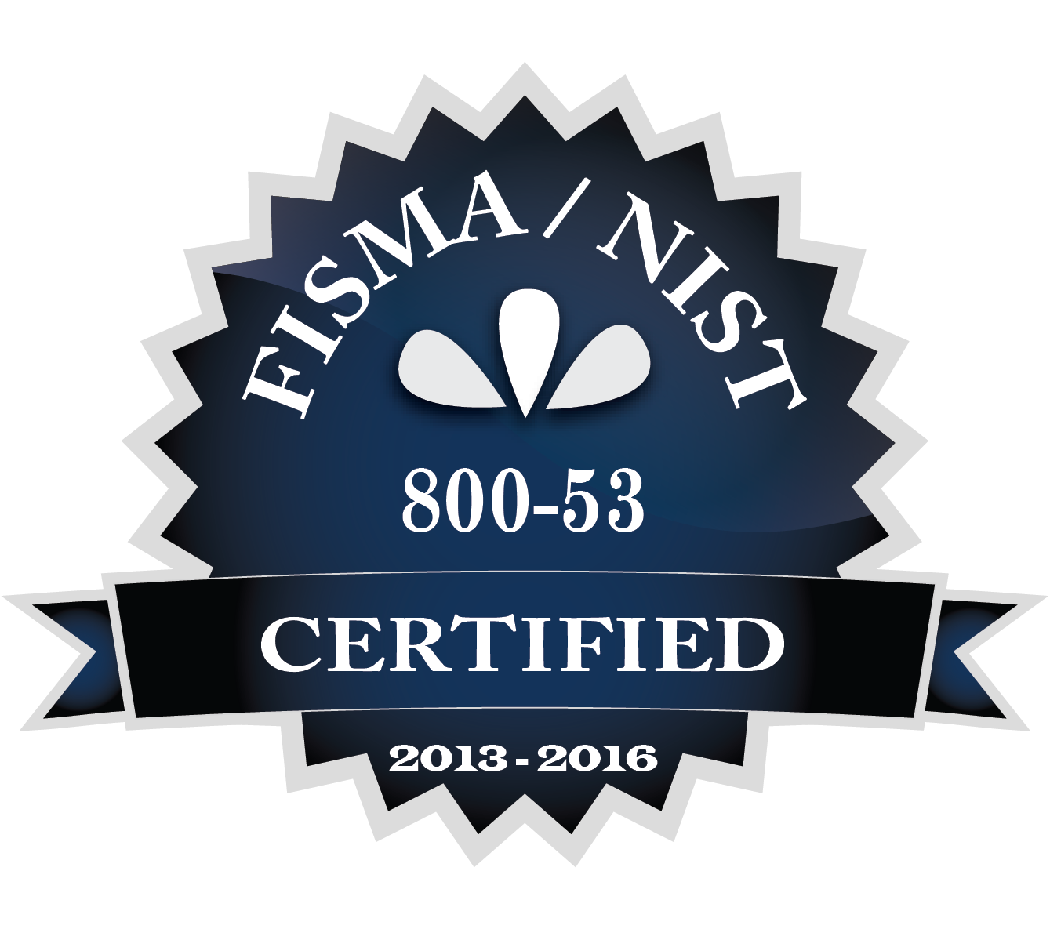
Step 5: Authorize Information System
NIST Publication: SP 800-37
Authorization to Operate
Can be revoked
Will be for specific # years
Annual OMB scorecards
Remember signatures
Notes:
https://nvlpubs.nist.gov/nistpubs/SpecialPublications/NIST.SP.800-37r1.pdf Guide for Applying the Risk Management Framework to Federal Information Systems A Security Life Cycle Approach

Slide 15
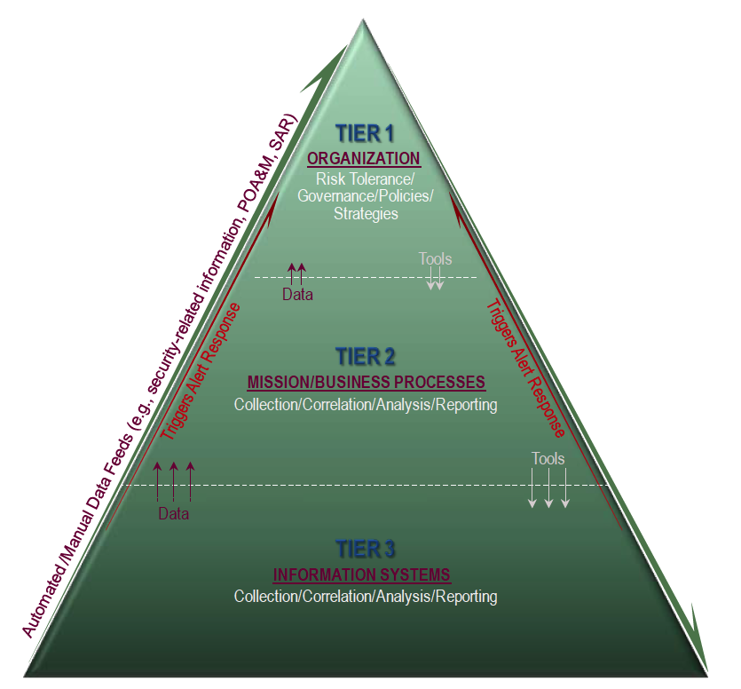
Step 6: Monitor Information Systems
NIST Publication: SP 800-137
ISCM * NSM * SIEM * Vulns
POA&Ms
Processes
Risk assessments
Policy updates
Notes:
https://nvlpubs.nist.gov/nistpubs/Legacy/SP/nistspecialpublication800-137.pdf
Information Security Continuous Monitoring (ISCM) for Federal Information Systems and Organizations

Slide 16
Cost of FISMA
Skills development
Creation and appointment of roles
Ongoing paperwork
Program management
Continuous monitoring
External assessments (audits)
Conceptual shift from open science culture
Notes:
Organizations will need to learn NIST and requirements of FISMA as a skillset
Organizations may need to add skillsets for additional tools and processes
Risk rating for employee positions and background checks - additional fields in HR tools
Additional work/scope required for managers and executives - goals need to be in employee annual reviews

Slide 17
Skills Development
Technical writing and document management
Interpreting NIST language
Schedule and project management
Risk assessment
Technical tools administration
Patience and perseverance

Slide 18
Additional Roles
System Owners
Executive CISO or S-CIO
ISSOs
Internal auditors
Compliance officers
Risk assessors
Technical Writers
Notes:
It’s not just about hiring a few more security engineers or system administrators

Slide 19
Prepare for Documentation
Invest in a secure documentation repository
Staff to ensure documents are kept current and archived appropriately
Choose a collaboration suite
Your agency may have a preference
SSPs are large documents - may have to invest in additional RAM or endpoint tools
Notes:
Collaboration - Box, Accellion
If your signatures have to go across multiple sites - electronic signing tools

Slide 20
Program Office
Needs authority
Needs stable funding
Needs clearly define scope of influence and operations
May either change or reinterpret tasks and processes across the organization

Slide 21
New Processes for Departments
HR - roles, risk rating by job title, background checks
Contracts - supply chain, security requirements in RFPs, language in contracts, vendor risk assessments
Legal - may need to learn new skills to handle IR and contracts disputes
Facilities - may need new badging system, cameras, or locks
PMO - needs to integrate security into project planning
IT - two-factor IAM, clearly defined Access Control

Slide 22
Continuous Monitoring
ISCM - SIEM, NSM, EP (AU and SI family) tools, processes and staff
POA&M management tools, processes and staff
Cyclical risk assessments tools, processes and staff
Vulnerability (REMEDIATION) management - patches and configurations
Lot of reporting
Someone must read and respond to the reports
Notes:
The fun stuff is setting up alerting with Bro and Splunk and Qualys or Alienvault, WAFs and EP, DLP and Honeypots

Slide 23
Culture Shift
Open Science is usually just funded for the science
Many researchers are not used to a structured operational framework
Organization may be grant funded and relatively distributed authority
Strict SDLC/Configuration Management conflicts with “Agile”
Science Docker containers are not secured
Teams may not have staff for full SDLC testing
IdPs (XSEDE, GLOBUS) may not have posted IA/AC procs

Slide 24
Reduce, Reuse, Recycle
If you have any kind of cybersecurity program or framework in place, you can translate between it and NIST.
NIST SP 800-53 is decomposition at it’s finest.
https://nvd.nist.gov/800-53 (Rev 4)
Always pack a towel*
Notes:
https://www.goodreads.com/quotes/24779-a-towel-the-hitchhiker-s-guide-to-the-galaxy-says-is “A towel, [The Hitchhiker's Guide to the Galaxy] says, is about the most massively useful thing an interstellar hitchhiker can have. Partly it has great practical value. You can wrap it around you for warmth as you bound across the cold moons of Jaglan Beta; you can lie on it on the brilliant marble-sanded beaches of Santraginus V, inhaling the heady sea vapors; you can sleep under it beneath the stars which shine so redly on the desert world of Kakrafoon; use it to sail a miniraft down the slow heavy River Moth; wet it for use in hand-to-hand-combat; wrap it round your head to ward off noxious fumes or avoid the gaze of the Ravenous Bugblatter Beast of Traal (such a mind-boggingly stupid animal, it assumes that if you can't see it, it can't see you); you can wave your towel in emergencies as a distress signal, and of course dry yourself off with it if it still seems to be clean enough.”

Slide 25
AC - Access Control
Policies and Procedures
AC-2
Account Management
AC-3
Access Enforcement
AC-7
Unsuccessful Logon Attempts
AC-8
System Use Notification
AC-14
Permitted Actions Without Identification or AuthN
AC-17
Remote Access
AC-18
Wireless Access
AC-20
Use of External Information Systems
AC-22
Publicly Accessible Content
AT - Awareness and Training
Policies and Procedures
AT-2
Security Awareness Training
AT-3
Role-Based Security Training
AT-4
Security Training Records
AU - Audit and Accountability
AU-2
Audit Events
AU-3
Content of Audit Records
AU-4
Audit Storage Capacity
AU-5
Response to Audit Processing Failures
AU-6
Review, Analysis, Reporting
AU-8
Timestamps
AU-9
Protection of Audit Information
AU-11
Audit Record Retention
AU-12
Audit Generation
CA - Security Assessment
Policies and Procedures
CA-2
Security Assessments
CA-3
System Interconnections
CA-5
Plan of Action and Milestones
CA-6
Security Authorization
CA-7
Continuous Monitoring
CA-9
Internal System Connections
CM - Configuration Management
Policies and Procedures
CM-2
Baseline Configuration
CM-3
Configuration Change Control
CM-4
Security Impact Analysis
CM-6
Configuration Settings
CM-7
Least Functionality
CM-8
Component Inventory
CM-10
Software Restrictions
CM-11
User Installed Software
CP - Contingency Planning
Policies and Procedures
CP-2
Contingency Plan
CP-3
Contingency Plan Training
CP-4
Contingency Plan Testing
CP-9
System Backup
CP-10
System Reconstitution
IA - Identification and Authentication
Policies and Procedures
IA-2, (1), (12)
Identification and Authentication
IA-4
Identifier Management
IA-5, (1), (11)
Authenticator Management
IA-6
Authenticator Feedback
IA-7
Cryptographic Module AuthN
IA-8 (1), (2), (3), (4)
Identification and Authentication for Non-Organizational Users
IR - Incident Response
Policies and Procedures
IR-2
IR Training
IR-4
IR Handling
IR-5
IR Monitoring
IR-6
IR Reporting
IR-7
IR Assistance
IR-8
IR Plan
MA - Maintenance
Policies and Procedures
MA-2
Controlled Maintenance
MA-4
NonLocal Maintenance
MA-5
Maintenance Personnel
MP - Media Protection
Policies and Procedures
MP-2
Media Access
MP-6
Media Sanitization
MP-7
Media Protection
PE - Physical and Environmental
Policies and Procedures
PE-2
Physical Access Authorization
PE-3
Physical Access Control
PE-6
Monitoring Physical Access
PE-8
Visitor Access Records
PE-12
Emergency Lighting
PE-13
Fire Protection
PE-14
Temperature and Humidity
PE-15
Water Damage Protection
PE-16
Delivery and Removal
PL - Planning
Policies and Procedures
PL-2
System Security Plan
PL-4
Rules of Behavior
PS - Personnel Security
Policies and Procedures
PS-2
Position Risk Designation
PS-3
Personnel Screening
PS-4
Personnel Termination
PS-5
Personnel Transfer
PS-6
Access Agreements
PS-7
Third Party Personnel
PS-8
Personnel Sanctions
RA - Risk Assessment
Policies and Procedures
RA-2
Security Categorization
RA-3
Risk Assessment
RA-5
Vulnerability Scanning
SA - System Acquisition
Policies and Procedures
SA-2
Allocation of Resources
SA-3
SDLC
SA-4, (10)
Acquisition Process
SA-5
Information System Docs
SA-8
System Engineering Principles
SA-9
External IS Services
SC - System and Communications
Policies and Procedures
SC-5
Denial of Service Protection
SC-7
Boundary Protection
SC-12
Cryptographic Key Management
SC-13
Cryptographic Protection
SC-15
Collaborative Computing Devices
SC-20
Secure Name/Address Resolution Authoritative Source
SC-21
Secure Name/Address Resolution Recursive Resolver
SC-22
Architecture&Provisioning Name/Address Service
SC-39
Process Isolation
SI - System and Information Integrity
Policies and Procedures
SI-2
Flaw Remediation
SI-3
Malware Protection
SI-4
System Monitoring (IDS)
SI-5
Security Alerts and Advisories
SI-12
Information Handling &Retention
Notes:
Everything in bold is “Policy and Procedures”. An example of a policy is “All laptops must have anti-virus protection installed”. An example of a procedure is on a team sharepoint or wiki drive, and it might say “After installing the operating system image, install anti-virus by downloading the latest version from the vendor site, check the SHA-1 hash is correct after downloading and then update the AV signatures to the latest version.” Select “Auto-Update”. An implementation detail would be more granular with exact steps and URLs. You most likely already have policies and procedures defined for normal IT operations. You may, like us, have different procedures practiced by different teams. You may have different policies for different types of systems. You may only have very high level policies but track down everything you have in writing.

Slide 26
Granular Details
AC-2 ACCOUNT MANAGEMENT
You Probably Already Have:
Control Description
The organization:
a. Identifies and selects the following types of information system accounts to support organizational missions/business functions: [Assignment: organization-defined information system account types];
b. Assigns account managers for information system accounts;c. Establishes conditions for group and role membership;
d. Specifies authorized users of the information system, group and role membership, and access authorizations (i.e., privileges) and other attributes (as required) for each account;
e. Requires approvals by [Assignment: organization-defined personnel or roles] for requests to create information system accounts;
f. Creates, enables, modifies, disables, and removes information system accounts in accordance with [Assignment: organization-defined procedures or conditions];
g. Monitors the use of information system accounts;
h. Notifies account managers:
1. When accounts are no longer required;
2. When users are terminated or transferred; and
3. When individual information system usage or need-to-know changes;
i. Authorizes access to the information system based on:
1. A valid access authorization;
2. Intended system usage; and
3. Other attributes as required by the organization or associated missions/business functions;
j. Reviews accounts for compliance with account management requirements [Assignment: organization-defined frequency]; and
k. Establishes a process for reissuing shared/group account credentials (if deployed) when individuals are removed from the group.
Active Directory
Group Memberships
HR, or team Manager, knows to add to various groups based on role
AD Admins defined
Account creation, deletion and helpdesk process to request access to objects and services
Managers have to approve account creation
Managers get email notifications when things are changed
An employee termination process where the account is removed within 24 or 48 hours

Slide 27
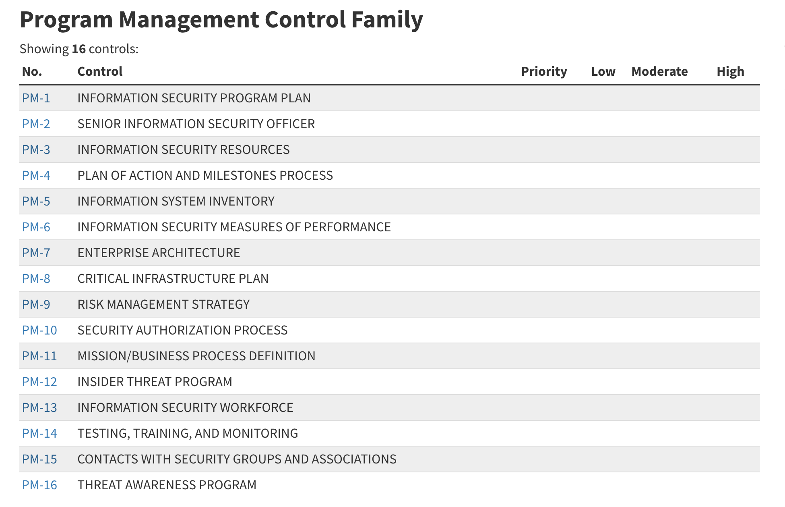
This means you hire people who are dedicated to IT Security.
Notes:
Tie all of this slide back to what Craig said this morning about establishing a program.

Slide 28
Do a Risk Assessment Before the FIPS-200
Once you have your asset inventory for the System and the baseline Low, Moderate or High, do your own risk assessment:
Go through each control and figure out what risk would remain if you don’t do it (mitigation, transfer, avoidance…)
Use this to discuss and negotiate out (tailor) any controls that don’t make sense
Every control you tailor out is dollars to thousands of dollars of time, rework, and upkeep
Notes:
Use Anurag’s example of a control checklist.
Refer to Craig’s presentation this morning.

Slide 29
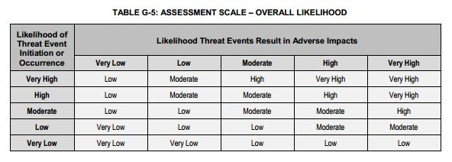
NIST Risk Assessment
Likelihood x Impact
Notes:
https://nvlpubs.nist.gov/nistpubs/Legacy/SP/nistspecialpublication800-30r1.pdf

Slide 30
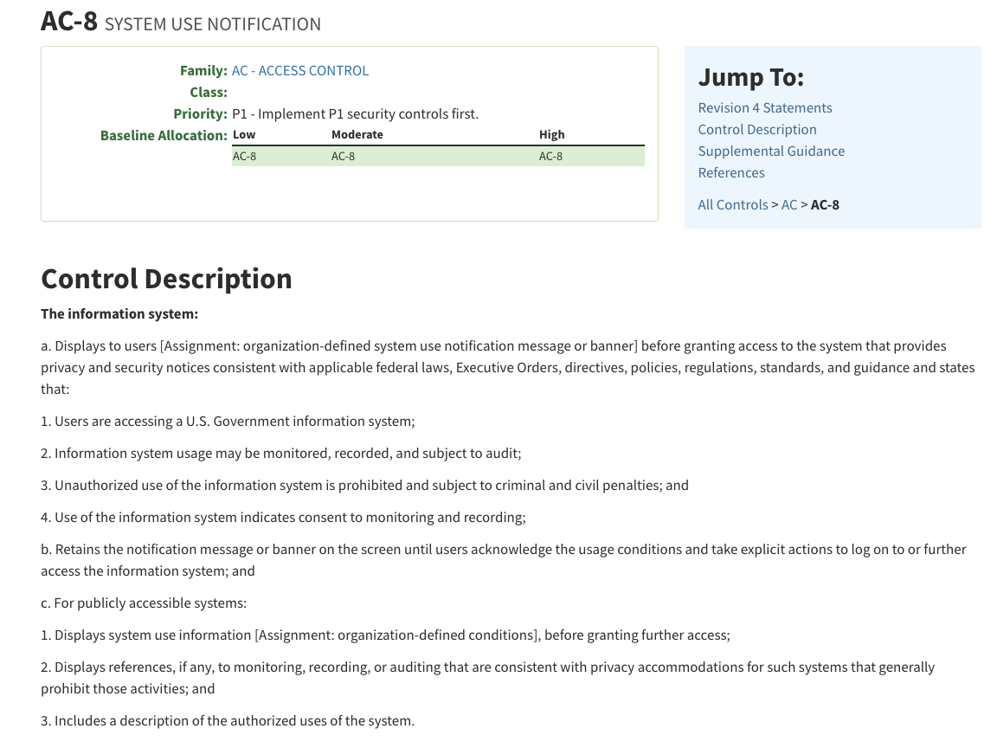
Translate the Control into Real Mitigation
What does this mitigate? Criminals don’t care about system use notifications!!!!!!

Slide 31
Threats Matched to Mitigating Controls
Threat | Controls that Mitigate Likelihood | Controls that Mitigate Impact
Insider Given Inappropriate Access | AC, AC-5, AC-8, AC-6, AT, CA-2, CA-6, CA-7, CM, IA, PS-4 | AC, AC-2, AC-3, AT, AU, CA-2, CA-7, CM, IR
Insider Escalates Privilege | AC, AC-7, AT, AU, CA, CM, IA, IA-5, PE, PL, PL-4, PS, PS-3, RA-5, SI, SI-2, SI-3, SI-4 | AT, AU, AU-6(2), CA-7, CM, IA, IA-4, IA-5(1)(e), SI, SI-4
Attacker Hijacks Open Terminal Session | AC, AC-6(1), AT, AU, CA, CM, IA, IA-4, PE, PL, PL-4, PS, PS-3, RA, RA-5 | AC, AC-3, AC-5, AC-6, AU, CA-7, CM, IR, SI, SI-4
Network Attacker Port Scans External or DMZ Devices | AC, AC-6(1), CA, CA-7, CM, CM-7, RA, RA-5, SC-7, SC-7(5), SI | AU, CA-7, CM, CM-7, IR, SA, SA-8, SI-4
Network Attacker Port Scans Internal Devices | AC, AC-6(1), CA, CA-7, CM, CM-7, PL, PL-8, RA, RA-5, SA, SA-8, SC-7, SC-7(5) | AU, CM, CA-7, CM-7, IR, SA, SA-8, SI, SI-4
Network Attacker Mines Public Facing Websites | AC, AC-21, AC-22, AT, CA, CA-2, CA-7, CM, PL | AU, CA-7, CM, SI, SI-4
Network Attacker Mines Social Media | AT, PL, PL-4 | AT, PL-4
Notes:
Happy to share my threat tables. Maybe this is not really a good example but it may be the difference between being able to fire someone who claims ignorance, or prosecute someone who claims ignorance. If this is not a risk to your organization, then tailor out this control!
https://nvlpubs.nist.gov/nistpubs/Legacy/SP/nistspecialpublication800-30r1.pdf

Slide 32
Threat Type | Threat | Description of Threat | NIST 800-53/800-171 Related Control Family | CIS 20 CSC Security Controls
Inappropriate Access/Use (C,I,A)
 | Insider Given Inappropriate Access | Insider is inadvertently given access that allows exposure of data or risks availability due to lack of training or expertise. | AC, AC-5, AC-6, AT, AU, CA, CM, IA, IR, PS | 1, 2, 3, 5, 14, 16, 19
 | Insider Escalates Privilege | Insider with authorized access deliberately obtains additional access to local systems or data without authorization. | AC, AC-7, AT, AU, CA, CM, IA, IA-5, IR, PE, PL, PL-4, PS, SI, SI-2, SI-3, SI-4 | 1, 2, 3, 4, 5, 6, 8, 16, 19
 | Insider Hijacks Open Terminal Session | Insider with access, or intruder on premise, gains other user access, privileged or unprivileged, by hijacking an existing terminal session and/or stored tokens (ie, unlocked screen, browser cookie, session ID, Kerberos ticket). | AC, AC-11, AC-12, AT, AU, CA, CM, IA, IR, PE, PS, RA, RA-5, SI | 1, 2, 3, 4, 6, 17, 19
 | Network Attacker Port Scans External or DMZ Devices | Network attacker takes advantage of open ports and protocols to scan external network devices and hosts, DMZ (Semi-Exposed) networks for open services that can be exploited or for competitor intelligence. | AC, AC-6(1), AU, CA, CM, CM-7, RA, SC-7, SC-7(5), SI | 1, 2, 3, 9, 11, 12, 15

Slide 33
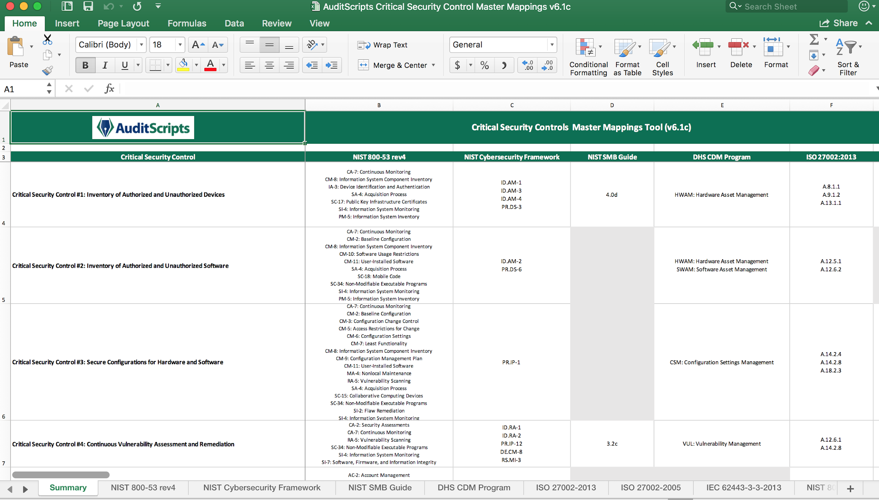
Notes:
If you take the SANS 566 Implementing and Auditing the Critical Security Controls, or you buy a membership to CISecurity, you get access to these wonderful spreadsheets that map the controls across a number of frameworks. https://www.auditscripts.com/free-resources/critical-security-controls/

Slide 34
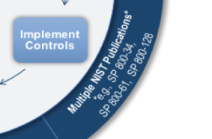
PLAN AHEAD, before you get to Step 3: Implement Controls
NIST expects you to already have contracts processes that outline security requirements for procurements, supply-chain vetting, background checks for personnel, risk assessment processes, tools for change management, two-factor authentication in place, maintenance procedures for vendors on site, a PMO office that integrates security requirements into project plans, a CONOPS, an SDLC, before you reach this point.
Notes:
https://csrc.nist.gov/publications/detail/sp/800-160/vol-2/draft
Your first FISMA system requires you to establish an entire program.

Slide 35
Document ahead of time:
Organization
Hybrid
System Specific
Cloud Provider
Who implements and maintains the control?
AC-2 | Control Summary Information
Responsible Role: IAM Team
Parameter AC-2(a): individual, shared, group, system, guest/anonymous, emergency, developer, administrator, manufacturer/vendor, and service
Parameter AC-2(e): IAM Team
Parameter AC-2(f): IAM Team
Parameter AC-2(j): IAM Team
Implementation Status (check all that apply): Implemented Partially implemented Planned Alternative implementation Not applicable
Control Origination (check all that apply): Organization System Specific Hybrid (Corporate and System Specific) Configured by Customer (Customer System Specific) Inherited from pre-existing Provisional Authorization (PA) for System,

Slide 36
You Probably Have Most of It in Place
Contracts processes, approved or preferred vendors, RFP/RFI templates - maybe add one line here or there calling our security requirements
Supply Chain - “We buy only Made in USA for Government contracts”, and you may already have vendor security assessments as a best practice
Configuration Management - Ansible, Puppet, Docker, Jira, Jenkins, email threads, team meetings
SDLC - part of every management framework
Security checklists - hardening steps, OWASP Top 10, CIS Benchmarks, SCAPs, STIGS, Windows templates - already should be in place
CONOPS - PL-7 is not in Low, Moderate or High baseline - use a general planning doc and just define a Security Architecture for your system (CIS)
Some kind of central logging and vulnerability or patching processes
Notes:
But maybe not documented.

Slide 37
Use Templates
https://www.fedramp.gov/templates/
Or from your Agency
Or build your own (costly)
Consider maintaining multiple sections for performance or granular assignment
There is a business opportunity here

Slide 38
Annual Additional Documents
Business Continuity Plan (BCP) including DR Plan
Configuration Management Plan (CMP)
Interconnect Security Agreements (ISAs)
Business Impact Analysis (BIA)
Risk Assessment Report (RAR)
Continuous Monitoring Plan (with POA&M management)
Incident Response Plan (IRP)

Slide 39
Configuration Management
One of the hardest to adopt
Consider Puppet, Ansible, Chef, Jenkins
Describe ServiceDesk process already in place
Containers
Intended to incorporate risk assessment and BIA
Assign an authorizer, and ensure that person is often available
This can be described and done as a “weekly team meeting”
Notes:
https://nvlpubs.nist.gov/nistpubs/Legacy/SP/nistspecialpublication800-128.pdf
https://nvlpubs.nist.gov/nistpubs/specialpublications/nist.sp.800-190.pdf

Slide 40
Incident Response
If you have an organization that has a very cautious legal or executive team, it’s important to reach out ahead of time to ensure that they are comfortable with 72 hour IR reporting requirements, and you need to negotiate what can be shared.
Write an Incident Response Plan that protects your business and your contract (NIST SP 800-61r2)
Create a clear communications and escalation procedure for your agency
Define roles and responsibilities
You may have to get one or more folks at your organization set up with a CAC card, CAC card reader, and buy a medium assurance certificate used to access the DOD IR system.
You may have to follow your Agency’s procedures for IR
Notes:
https://nvlpubs.nist.gov/nistpubs/specialpublications/nist.sp.800-61r2.pdf

Slide 41
POA&Ms
Plans of Action and Milestones buy time
Think of them as written out Continuous Process Improvement (CPI) mini-project plans
It’s a good idea to put them in employee annual review goals
Your POA&M process may be integrated into your Federal Agency’s spreadsheets or POA&M management structure
You may need to formally write a POA&M management process in a Continuous Monitoring Plan (NIST SP 800-137)
Notes:
https://nvlpubs.nist.gov/nistpubs/legacy/sp/nistspecialpublication800-137.pdf

Slide 42
Assessments: Expect Findings
Editorial: The problem is not NIST, the problem is the auditors (and ...maybe SP 800-53a could be improved)
You will have findings
Turn the findings into POA&Ms
Or negotiate with your agency to accept the risk
Tailor out more in the FIPS-200
Scope, partner with auditors, or find better auditors
Store, manage, reuse your SAR and SAWP for RAR
Notes:
If you don’t have active and interested executives involved in this program, make it a point to sell your SAR...make it important to them.

Slide 43
WWRRD
“What Would Ron Ross Do?”
Show up at your organization and do a great presentation on FISMA and NIST and how important it is to prioritize cybersecurity.
Get his phone number and email - he will answer questions.

Slide 44
Considerations
Segmentation or “walled gardens” vs whole organization
Deploying in a FedRAMP Cloud (still requires lots of other policies, processes, and local controls)
Executive prioritization
Staff that are comfortable with decomposition and granularity (bean counters)
If you have to choose between security and compliance, decide which is your priority based on organization Mission
Ask if FISMA could impact innovation: at it’s best, security is an enabler, but getting there may take longer
Notes:
Cloud - easier to spin up and delete when done

Slide 45
References
https://www.sans.org/media/score/fisma-nist.pdf
https://www.dhs.gov/fisma
https://www.dhs.gov/publication/fy18-fisma-documents
https://csrc.nist.gov/publications/detail/sp/800-60/vol-1-rev-1/final
https://nvlpubs.nist.gov/nistpubs/FIPS/NIST.FIPS.199.pdf https://nvlpubs.nist.gov/nistpubs/FIPS/NIST.FIPS.200.pdf https://nvlpubs.nist.gov/nistpubs/Legacy/SP/nistspecialpublication800-60v2r1.pdf
https://csrc.nist.gov/publications/detail/sp/800-160/vol-2/draft
https://nvlpubs.nist.gov/nistpubs/Legacy/SP/nistspecialpublication800-128.pdf
https://nvlpubs.nist.gov/nistpubs/legacy/sp/nistspecialpublication800-34r1.pdf
https://nvlpubs.nist.gov/nistpubs/SpecialPublications/NIST.SP.800-53Ar4.pdf
https://nvlpubs.nist.gov/nistpubs/SpecialPublications/NIST.SP.800-37r1.pdf
https://nvlpubs.nist.gov/nistpubs/Legacy/SP/nistspecialpublication800-137.pdf
https://nvlpubs.nist.gov/nistpubs/Legacy/SP/nistspecialpublication800-30r1.pdf
https://nvlpubs.nist.gov/nistpubs/specialpublications/nist.sp.800-190.pdf
https://nvlpubs.nist.gov/nistpubs/specialpublications/nist.sp.800-61r2.pdf
https://www.auditscripts.com/free-resources/critical-security-controls/
https://www.cisecurity.org/controls/
https://www.goodreads.com/quotes/24779-a-towel-the-hitchhiker-s-guide-to-the-galaxy-says-is

Slide 46
Contact Info
Scott Russell
scolruss@iu.edu
Anurag Shankar
ashankar@iu.edu
Susan Ramsey
ramsey@ncar.edu

