Slide 1
Silent Librarian: An Analysis of Events & Next Steps
Kim Milford
Brett Zupan

Slide 2
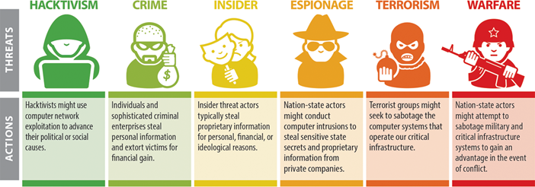
Threats
Notes:
What are these attackers after? Attacks typically target data, people, or infrastructure.
•Intellectual property – Intellectual property is the lifeblood of many organizations. Theft of such information can affect the long-term survival of the organization.
•Personally Identifiable Information (PII) – Some organizations possess large amounts of PII. A leak of this information can cause damage to their customers and civil liability exposure.
•Money – Monetary losses can result from denial of service to critical business systems. These critical assets should be identified and more resources should be spent on protecting them over less critical corporate assets.
Due to the asymmetric nature of cyber attacks, it can be difficult to determine when or where an attack will occur, but having an understanding of what information your organization possesses that is of value to an attacker is critical to determining where to spend the most security resources.
Reminder: Evolving threats

Slide 3
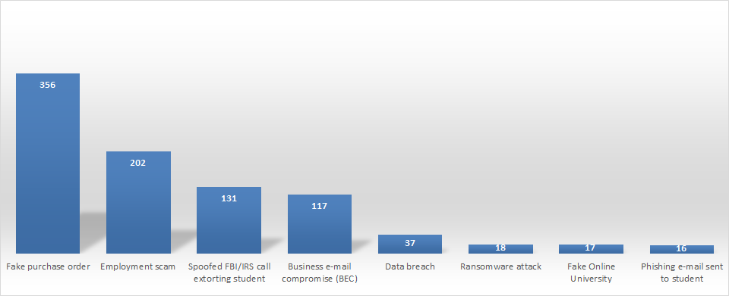
FBI: Recent Trends in Crimes Targeting Academia
Notes:
·1) Employment Scam or Job Opportunity Scam: posted on university job board (NOT covered in PPT)
·Common check fraud scam where students apply for a “mystery shopper” job
·
·2) Spoofed FBI/IRS call extorting student AKA Fake “Education Tax” Scheme in PSA (NOT covered in PPT)
·
·3) BEC includes:
·Vendor Bank Account Information Update (more about this later)
·Phishing incidents to obtain W-2 information (more about this later)
·Phishing incidents to alter direct deposit information (more about this later)
·

Slide 4
Silent Librarian: What is it?
A series of over 750 phishing attacks conducted by Mabna Institute
Began in September 2013, still continuing
Over 31 Terabytes of academic data stolen
Sold to Megapaper.ir, Gigapaper.ir, Uniaccount.ir
Transmitted to the Islamic Revolutionary Guard Corp
FBI Estimated Cost of Attacks to Universities: $3.4 billion
Source: Silent Librarian: More to the Story of the Iranian Mabna Institute Indictment, PhishLabs/Silent Librarian University Attacks Continue Unabated in Days Following Indictment, PhishLabs, Nine Iranians Charged With Conducting Massive Cyber Theft Campaign on Behalf of the Islamic Revolutionary Guard Corps, FBI

Slide 5
Silent Librarian: Attack Targets
144 U.S.-based universities
176 foreign universities in 21 other countries
Almost 50 domestic and foreign companies
The states of Hawaii and Indiana
The United Nations
100,000 accounts associated with professors targeted
8,000 compromised
Source: Nine Iranians Charged With Conducting Massive Cyber Theft Campaign on Behalf of the Islamic Revolutionary Guard Corps, FBI
Notes:
100,000/8,000 – 8% success rate
Compared to PhishMe’s average Organizational Susceptibility being 10.8% in 2017

Slide 6
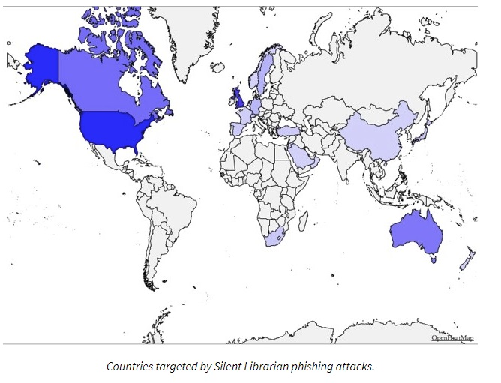
Attack Map

Slide 7
Attack Cycle
Targets receive spear phishing emails
Links in emails redirect targets to malicious domains
Credentials entered and stolen
Stolen credentials used to exfiltrate data
Data given to government and monetized
Image: How Enterprise Phishing Works, TrueThreat

Slide 8
Mitigations – Spear Phishing
Consistent and unique user education
Implement DMARC
Create a method of reporting
Image: Silent Librarian: More to the Story of the Iranian Mabna Institute Indictment, PhishLabs

Slide 9
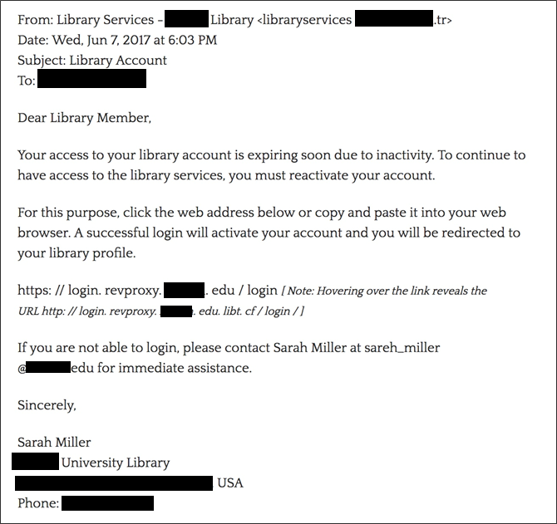
Image: Silent Librarian: More to the Story of the Iranian Mabna Institute Indictment, PhishLabs

Slide 10
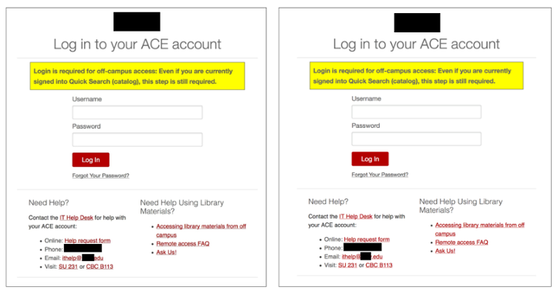
Mitigations – Domain Redirection
Check the link!
Use intelligence feeds to preemptively block
Image: Silent Librarian: More to the Story of the Iranian Mabna Institute Indictment, PhishLabs

Slide 11
Mitigations – Account Compromise
Enforce the use of secure passwords
Password manager
Use intelligence feeds (like REN-ISAC’s SES!) to keep aware of what credentials are being made available online

Slide 12
Investigation and Indictment Timeline
2017
August/
September
December
September
Spear phishing campaigns targeting faculty and students discovered
Attackers add SSL Certificates to create more realistic pages
Phishlabs begins tracking threat group
Law enforcement, ISAC and victim coordination begins
Notes:
Phishlabs used PassiveDNS analysis, Whois data, SSL certificate monitoring, and open source research to identify more phishing sites linked to the same group.
March 23, 2018: Nine Iranians associated with the Mabna Institute indicted for computer intrusion, conspiracy to commit computer intrusion, wire fraud, conspiracy to commit wire fraud, unauthorized access for private financial gain, and aggravated identity theft.
State sponsored: Mabna Institute, a private government contractor based in the Islamic Republic of Iran that performed this work for the Iranian government, at the behest of the Islamic Revolutionary Guard Corps.
All males, between the ages of 24 and 39
Per FBI: Mabna Institute was "created in 2013 for the express purpose of illegally gaining access to non-Iranian scientific resources through computer intrusions."
Acquired research that the US and other countries banned access to in Iran, providing it to the Islamic Revolutionary Guard Corps
Sold stolen research documents and access to victim organizations' online libraries and credentials
US Treasury: all property and interests in property of the designated persons subject to U.S. jurisdiction are blocked, and U.S. persons are generally prohibited from engaging in transactions with them.

Slide 13
Investigation and Indictment Timeline
2018
March
March
FBI notifies foreign law enforcement
DOJ indictments and Treasury imposes sanctions
Phishlabs discovers third sales portal for stolen credentials
Three other sales portals discovered
April
April -
Congressional Committee hearing
Attacks continue
post indictment
Notes:
Phishlabs used PassiveDNS analysis, Whois data, SSL certificate monitoring, and open source research to identify more phishing sites linked to the same group.
March 23, 2018: Nine Iranians associated with the Mabna Institute indicted for computer intrusion, conspiracy to commit computer intrusion, wire fraud, conspiracy to commit wire fraud, unauthorized access for private financial gain, and aggravated identity theft.
State sponsored: Mabna Institute, a private government contractor based in the Islamic Republic of Iran that performed this work for the Iranian government, at the behest of the Islamic Revolutionary Guard Corps.
All males, between the ages of 24 and 39
Per FBI: Mabna Institute was "created in 2013 for the express purpose of illegally gaining access to non-Iranian scientific resources through computer intrusions."
Acquired research that the US and other countries banned access to in Iran, providing it to the Islamic Revolutionary Guard Corps
Sold stolen research documents and access to victim organizations' online libraries and credentials
US Treasury: all property and interests in property of the designated persons subject to U.S. jurisdiction are blocked, and U.S. persons are generally prohibited from engaging in transactions with them.

Slide 14
Next Steps: Best Practices
Technical | Administrative
Adopt a defense-in-depth approach | Dismiss the “I’m not a target” mentality
Use scanning and inspection tools to find vulnerabilities and identify out-of-date software. | Assess your environment (including building control systems and cloud-based systems) periodically and deploy safeguards to manage risks.
Protect networks where sensitive functions are performed or sensitive data is stored using network security tools like firewalls and ACLs. | Document policies and procedures protecting institutional IT resources, and credentials, e.g., incident management and business continuity.
Use robust, reliable, state-of-the art AIM techniques. | Train IT professionals about threats, risks, and mitigation.
Aggressively patch OSes and applications. | Commit to ongoing education for end users.
Quickly block or quarantine compromised hosts. | Document, test, and maintain backup procedures/
Employ preventative measures, such as IDS, IPS, and DNS sinkholes. | Collect logs and monitor for incidents and suspicious behavior.

