Slide 1

Shared Threat Intelligence for Network Gatekeeping with Automated Response

Slide 2
What we’re covering
Threat Intelligence in Higher Ed
Duke’s Journey
STINGAR
An approach to supplementing vendor-supplied threat intelligence with organization-generated or crowdsourced threat intelligence.

Slide 3
What is Threat Intelligence?
DATA
ANALYSIS
Action

Slide 4
Common Types of Threat Data
IP
152.3.72.100
URL
http://it.duke.edu/support
Domain
security.duke.edu
MD5 (Threat_Intelligence.pptx) = fe0104beeb81d72654905648e5c51334
Email Addr
security@duke.edu
File Hash

Slide 5
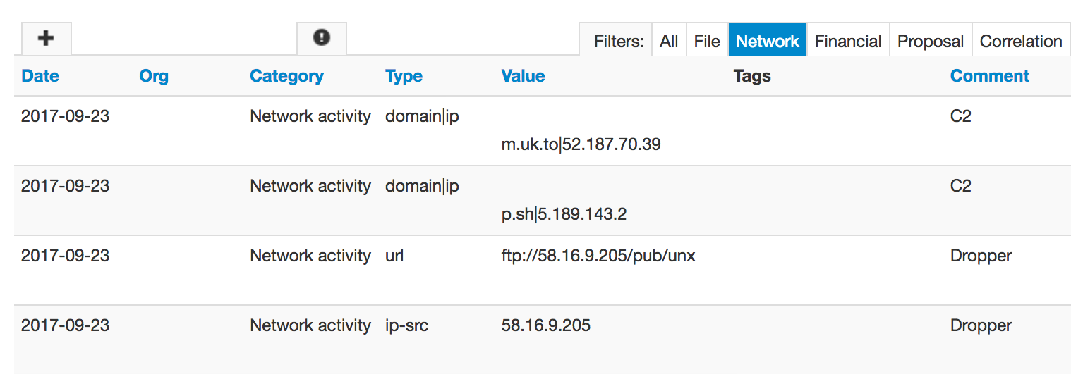
Sample of Threat Intelligence

Slide 6
Constructing an infrastructure
2014 – IPS (north/south) and IDS (east/west)
2014 –Splunk for analysis and action
2014-16 –honeypots and external lists
2016 – new firewalls and network flow collector
2017 –black hole routing and DNS query analysis
2018 - Virtualizing honeypots and sharing data
Components of our network defense program

Slide 7
Evolving the approach
STINGAR - Sharing Threat Intelligence for Network Gatekeeping with Automated Response
Make use of:
  network sensors
  network metadata system logs files
To identify and block:
  attackers
  compromised machines and accounts
AND share:
  threat intelligence with other groups

Slide 8
Automating a Solution
Sensors originate signals.
Analysis
Actuators respond to sensors
Automation for scale
IPS/IDS
Firewalls
Syslog/auth logs
Honeypots
Bro sensors
Splunk
Argus
Argus
Spark
IPS
Firewalls
Black Hole Routing
Sensors -> Actuators
Sensors -> Analysis
Analysis
Analysis -> Actuators

Slide 9






Honeypot
Science
DMZ
Edge
IPS/IDS
Campus
Network
Normal Data
Attack Data
Threat Intelligence
Honeypot
Control
Data collected near-real time
Sensor Data Aggregator
Analysis occurs between 1 min (most sources) and 5 min (network flow data)
Threat Response Actuators
Syslog services
Host Firewall insertion
Planned
Honeypot data
Threat
Analyzer
Threat
Repository
NetFlow captures
Network Firewall insertion
DenyHosts data
“Black hole” routing
< 3 seconds
Block lists generated every 3 minutes
IDS data
IPS insertion
30 min

Slide 10
Honeypots

Slide 11
Honeypot Statistics
7 honeypots deployed in Science DMZ
~3000 events per day
~200 unique IP addresses a day
Primary activity is network share scanning in addition to SSH and web authentication brute force attempts

Slide 12
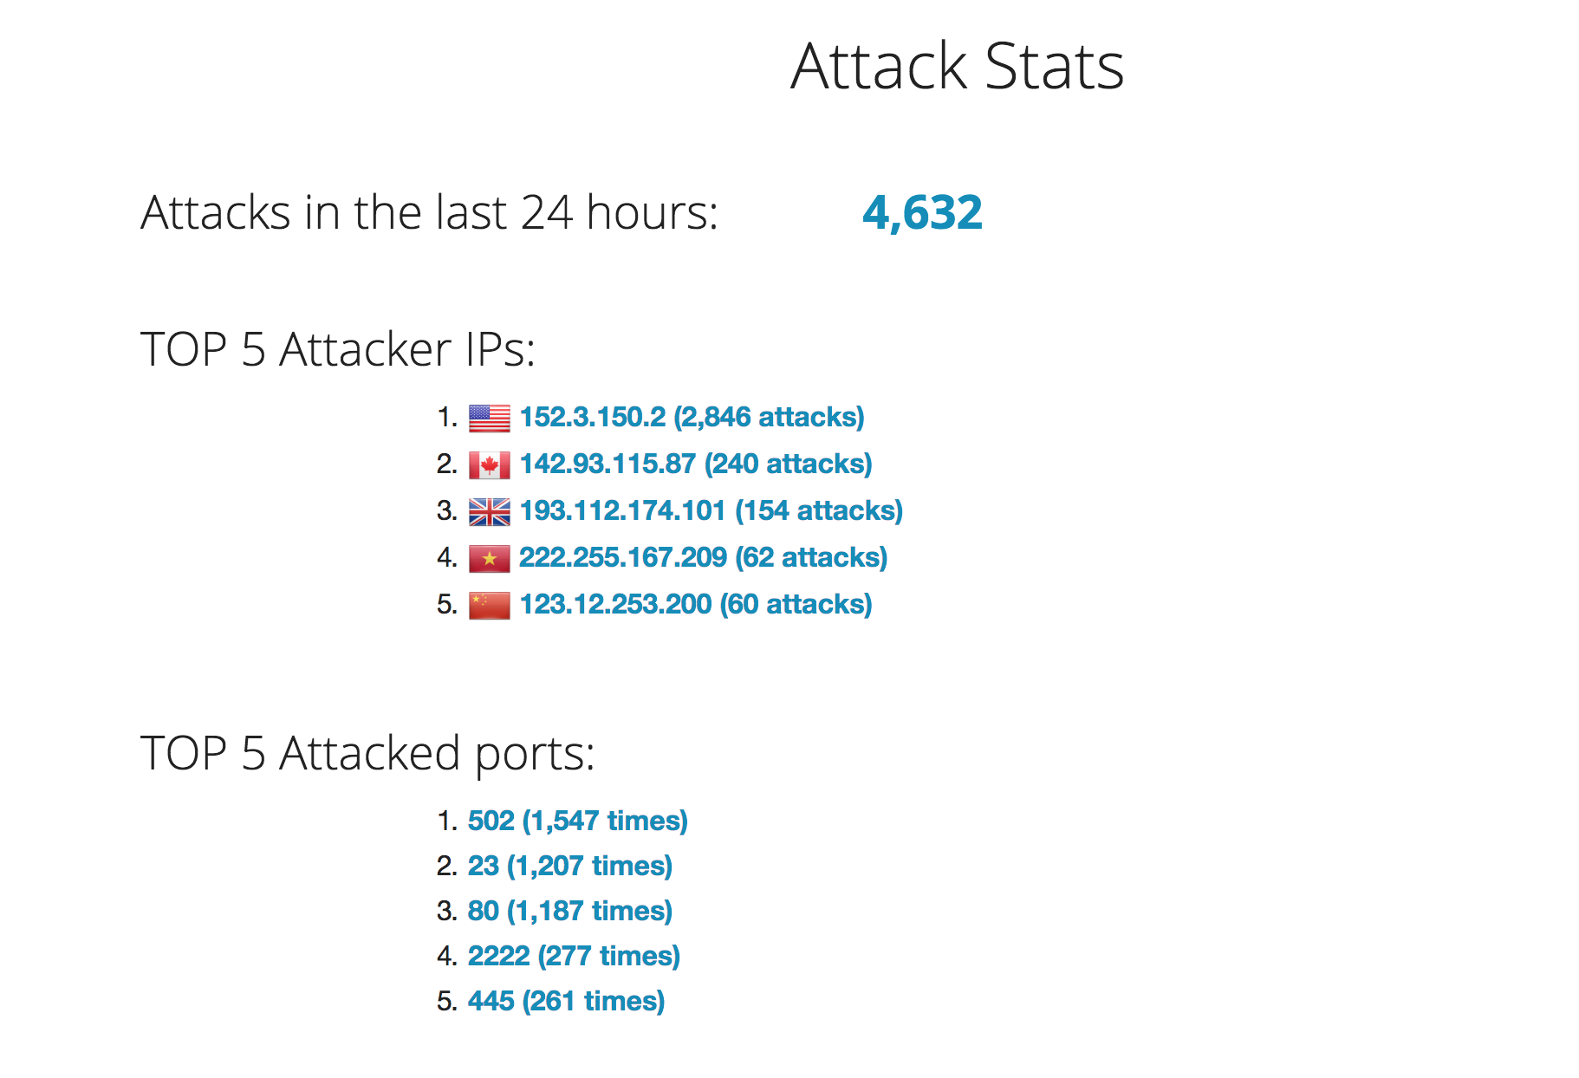
Attack Statistics

Slide 13
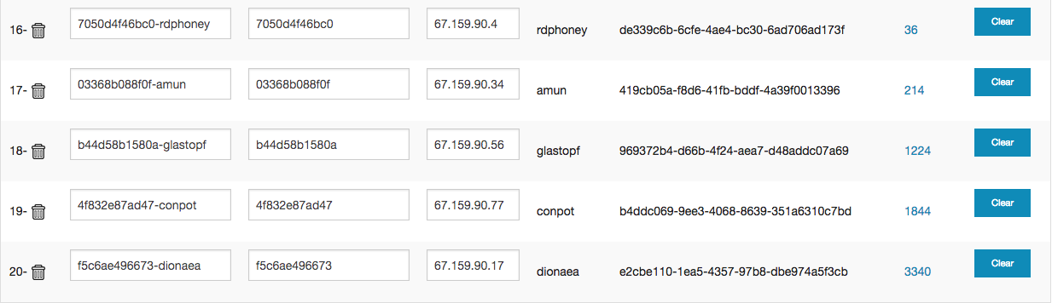
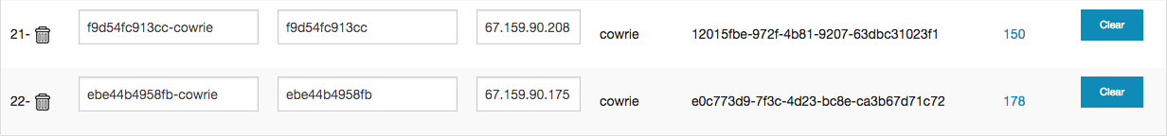
Sensor View

Slide 14
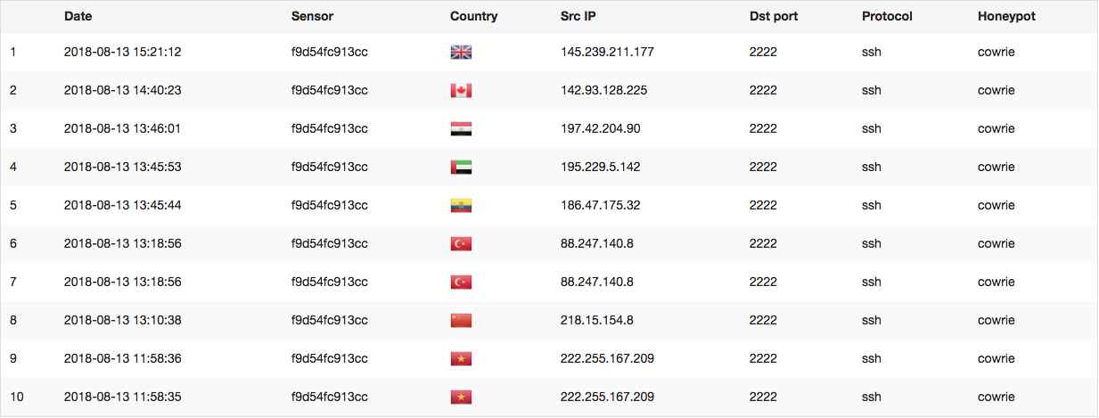
Attack details

Slide 15
Why not just run Honeypots?
Because containers and automation are fun!
Also…
  MHN appears to no longer be actively supported by Threatstream
  Designed as a monolithic architecture
  Dead dependencies
  Limited Python3 support

Slide 16
Honeypots Ready to Deploy
Cowrie
  SSH / Telnet honeypot
  Logs brute force attacks + shell sessions
Dionaea
  Multi-service honeypot
  Captures binaries, auto uploading to VirusTotal and Sandbox services
  FTP, HTTP, MySQL, MSSQL, SMB, SIP, TFTP, etc

Slide 17
Honeypots ready for alpha testers
Wordpot – Wordpress website honeypot
Conpot – SCADA device honeypot
Glastopf – Generic web honeypot
RDPHoney – Simple RDP honeypot
Amun – Low-interaction multi-service honeypot

Slide 18
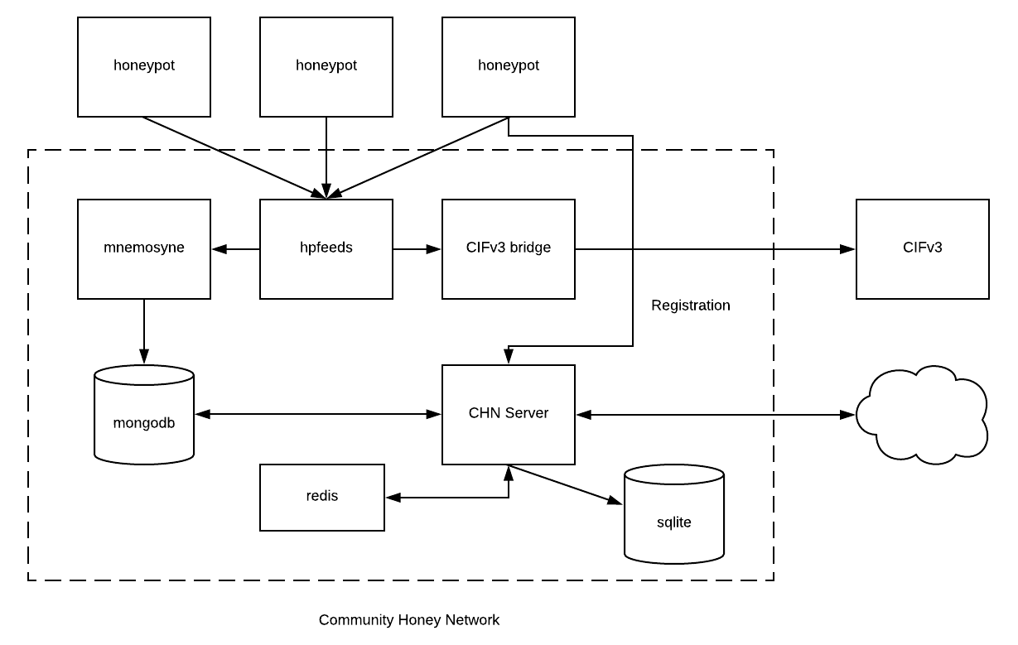
CHN – Current Architecture

Slide 19
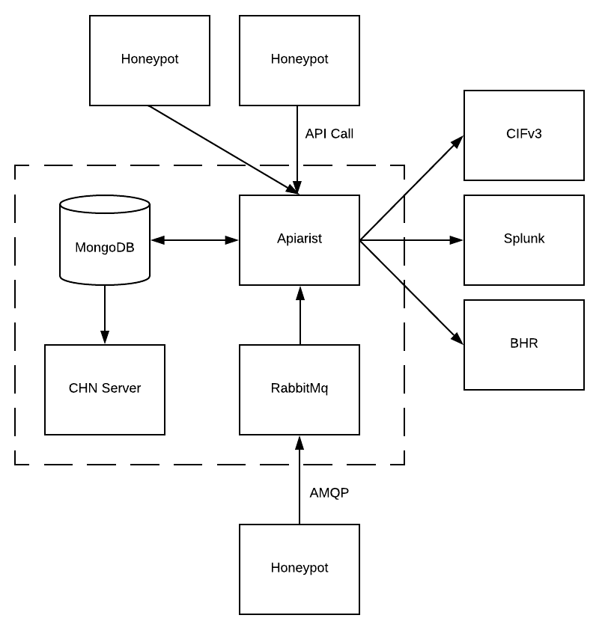
CHN – Future Architecture

Slide 20
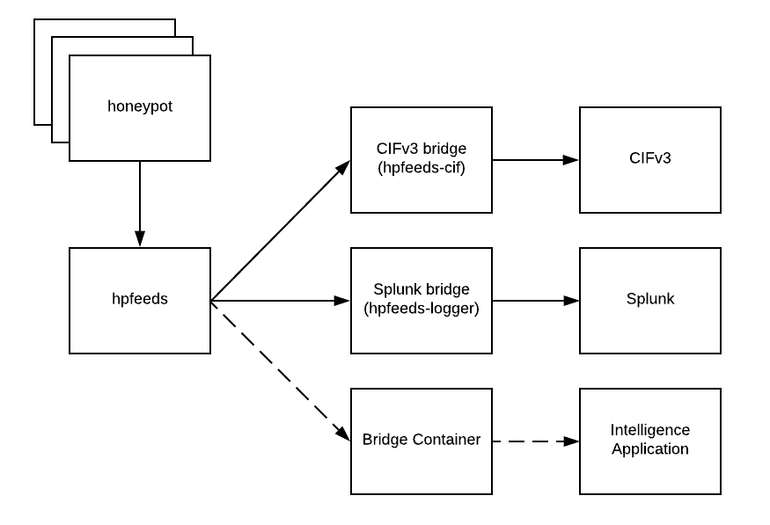
Integrating CHN with Other Applications

Slide 21
Impact: Connections Dropped
~4% of what we block in our bad actors and threat intelligence lists could also be blocked by SourceFire. The combined lists increase our efficacy 20 times.

Slide 22
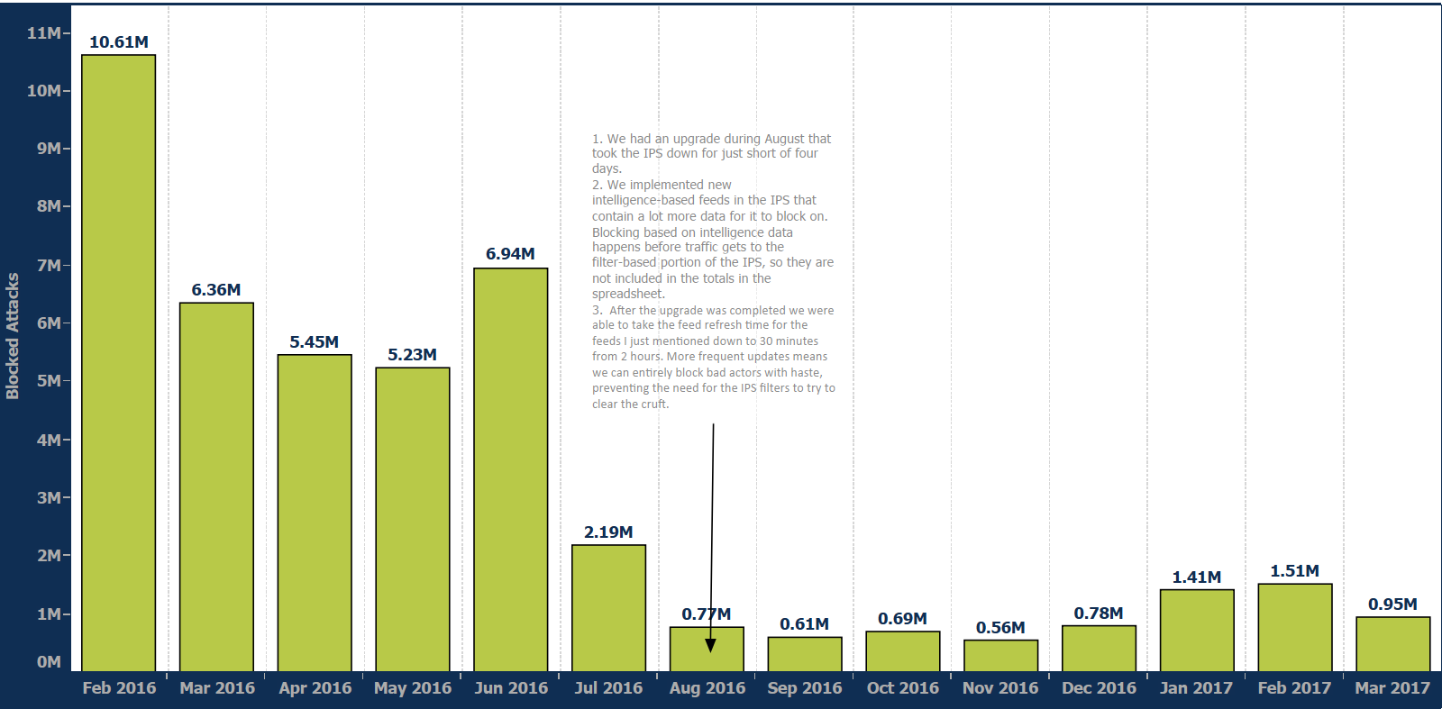
Impact: Alert Data
In 2016, began blocking on Threat Intelligence from external sources
At the same time, we began blocking based off internally developed intelligence
The result was less “noise” in the industry tools for analysts to sift through

Slide 23
Community sharing of intelligence
Beyond effective blocking of attacks, we desire to (a) share information and (b) get in the hands of researchers and analysts to identify new attacks.
REN-ISAC
Community partners

Slide 24


Data plane
The Outside World
Control plane
Network Edge
IPS
Sharing with the Community
Threat Response Actuators
SDN/
Science DMZ
Threat
Repository
Shared Threat
Repository
Threat Detection
Sensor
Value = 16,502 unique addresses/day shared to the group for blocking.
Campus
Network
Threat
Analyzer
Threat Detection Sensor
Sensor Data Aggregator
Partner Institutions

Slide 25
Next Steps
Documentation:
Communityhoneynetwork.github.io
Repository:
https://github.com/CommunityHoneyNetwork
Contact:
stingar@duke.edu
Developer Twitter Feeds:
@ChrisInDurham
@merckedsec
Richard.biever@duke.edu
Charley.kneifel@duke.edu

Slide 26
QUESTIONS?

