Slide 1
Involving Students in Cybersecurity for Cyberinfrastructure
Jeremy Straub
North Dakota State University

Slide 3
Cybersecurity @ NDSU
Cybersecurity Curriculum at NDSU
Ph.D. programs in Computer Science and Software Engineering with cybersecurity option
M.S. programs in Computer Science and Software Engineering with cybersecurity option
B.S. program in Computer Science with cybersecurity recognition
Graduate Certificate Program in Cybersecurity
Focus Areas
Cybersecurity Research
Cyber Defense
Cyber Operations
Cybersecurity Tool Development

Slide 4
Cybersecurity @ NDSU
Key Activities
We offered North Dakota’s first GenCyber summer camp in 2018. This brought K-12 students from all over the region to NDSU to learn about cybersecurity.
NSF-funded Research Experience for Undergraduates focused on cyber-physical system cybersecurity
Student competition teams
Key Capabilities
North Dakota’s first cyber range, developed with Department of Defense assistance
New cybersecurity laboratory: a dedicated 20+ station facility including Kali Linux terminals, a SCADA security simulator and cyber-physical systems
Mobile cyber lab

Slide 5
The Challenge
Student involvement in research and other technical activities is key to preparing the next generation of researchers, security professionals, technicians, programmers and other key roles.
Large, expensive, delicate and intricate infrastructure equipment presents a challenge of how to best involve students while ensuring that key research objectives and production systems are not at risk of impairment due to students interactions with them.
Security research presents risks related to its containment and the inadvertent insecurity, breach or impairment of systems – both those on which the research is conducted and others.

Slide 6
Incorporating Students
Needs to be exciting and informative to the students while minimizing the potential for harm to the systems and work
Projects can be student-centered or provide opportunities for student involvement
Focus on student-related outcomes, or
Have secondary / tertiary student-related outcomes, or
Provide opportunities for student involvement and learning while achieving non-student-related objectives
Projects may need student involvement for ‘broad impact’ requirements

Slide 7
Incorporating Students
Some examples:
NSF-funded Research Experience for Undergraduates program with focus on cyber-physical system cybersecurity
Ethical hacking – student system testers
Cybersecurity competitions
Capture the flag
Red team vs. blue team

Slide 8
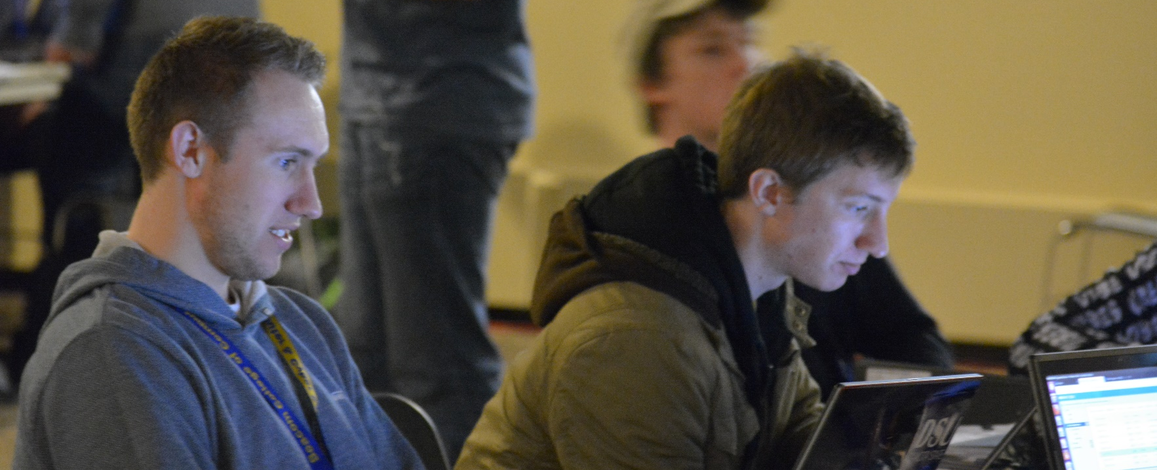
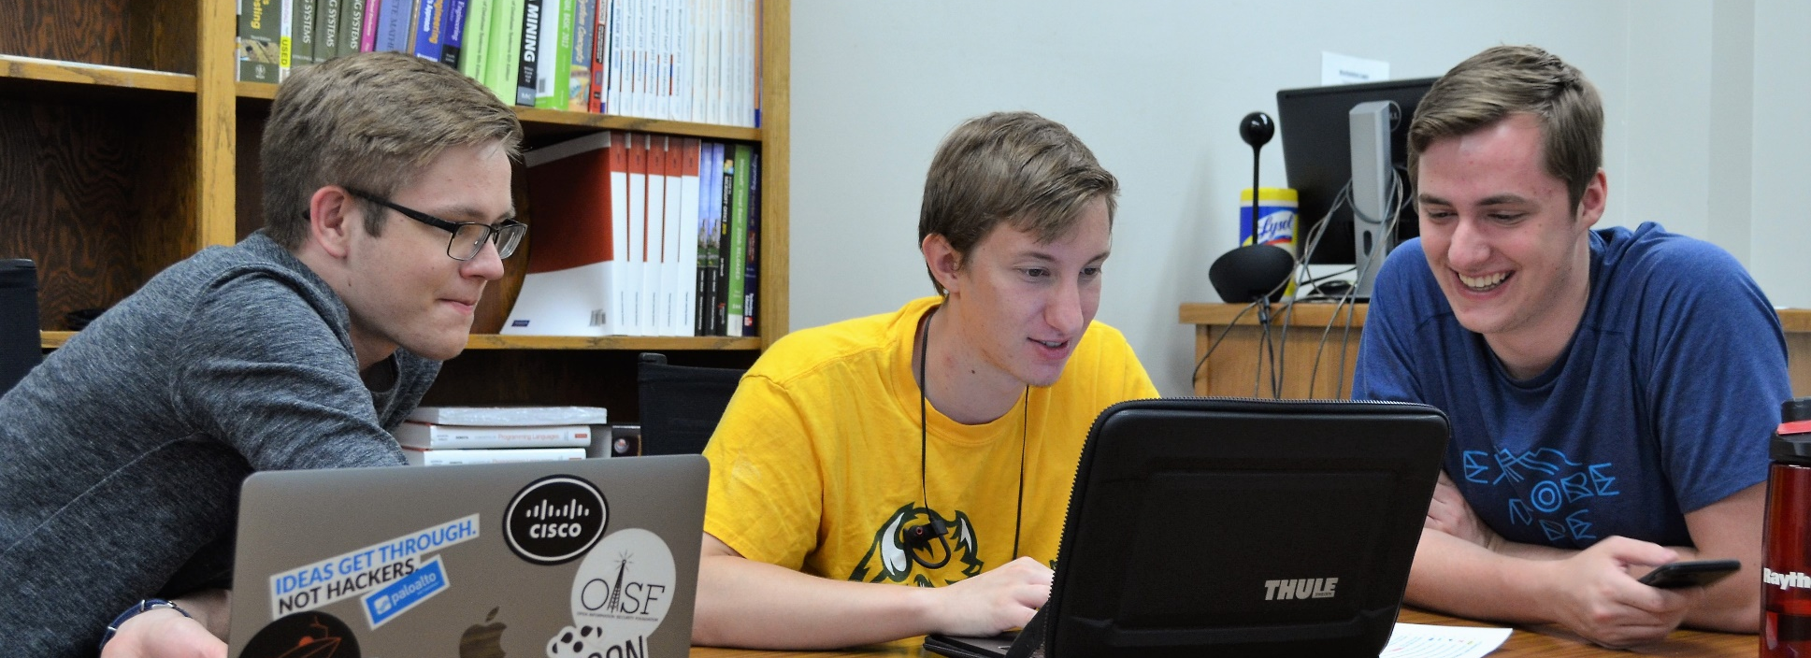
Student Perspective – Isaac Burton

Slide 14
Student Perspective – Isaac Burton

Slide 15
Courses
Provide foundational knowledge
We’re incorporating cybersecurity knowledge components into related (non-security) courses
Course projects provide an opportunity for student involvement in larger / external projects

Slide 16
Research Experience
Students help generate topics
Students do background research
Literature survey
Identifying prior foundational work
Identifying existing resources they can use
Software development
Validation - scientific method & engineering design process
Professional documentation

Slide 17
Cybersecurity Competitions
Provide students with an opportunity to test and demonstrate skills
Limited period of time, fits well with hectic student schedules
May be possible for students with time commitment issues that prevent participation in longer-term projects to participate and excel
Numerous competitions exist
Capture the flag – logic / puzzle / skill / knowledge competitions where ‘flags’ are determined or found and submitted to validate completion
Team vs. team – focus on securing or attacking systems
Can be used to generate student involvement in projects and programs – could your project support a competition?

Slide 18
Assessing Value to Students
We use multiple approaches to assess student learning
Comparative skill assessment surveys
URSSA – the Undergraduate Research Student Self-Assessment
Knowledge / skill tests – pre and post tests
Course-integrated metrics
We plan to measure longer-term value
Success in college / graduation
First job
Additional education
Career progression

Slide 19
Student Benefits to Projects
Students can bring several types of value to projects
Basic work
Meeting institutional / project funder goals
Workforce development for institution and/or funder
Special benefits from the perspective of faculty investigators and staff developers and system administrators
Cutting edge, recently-honed technical skills
‘Out of the box’ thinking
Viewing challenges from the perspective of a system user or consumer
What needs do your projects have that students can help meet?

Slide 20
What We’re Doing
Our goals are student-centric
Increased competition participation
Hosting cybersecurity competition as part of the Midwest Instruction and Computing Symposium (MICS) in 2019
Creating more research opportunities for students, seeking more funding for doing so
Working with outside partners to let students work on high-quality partner projects
Creating other student participation opportunities
Working with campus IT, outside partner entities
Participation ties in with degree programs
Course credit
Course projects topics
Capstone / thesis / graduate project topics

Slide 21
Take Away Strategies
Key questions:
How can students aid your project?
How can your project aid students?
Students are looking for experience, skill validation, rewards and fun activities
Can your project benefit from a competition?
Are there components of your project that can be isolated for use as a student project?
How does working on your project help students get a job (or a better job) after they graduate?

Slide 22
Thanks & Any Questions?
Jeremy Straub
jeremy.straub@ndsu.edu
701-231-8196

