Slide 1

This is a little story about four people named Everybody, Somebody, Anybody, and Nobody.
There was an important job to be done and Everybody was sure that Somebody would do it.
Anybody could have done it, but Nobody did it.
Somebody got angry about that because it was Everybody's job.
Everybody thought that Anybody could do it, but Nobody realized that Everybody wouldn't do it.
It ended up that Everybody blamed Somebody when Nobody did what Anybody could have done
* Poster from US
Department of Commerce

Slide 2
Cybersecurity 2011… and beyond
What Makes a Good Security Plan?
Ardoth Hassler
Senior IT Advisor
National Science Foundation
Associate VP University Information Services
Georgetown University
Notes:
2
Hello. My name is Ardoth Hassler. I am a Senior Information Technology Advisor at the National Science Foundation. In “real life,” I am Associate VP for University Information Services at Georgetown University. At NSF, I’ve been working on the project to remove SSNs from FastLane and on Cybersecurity for NSF Large Facilities.
At GU, I worked most recently in “policy, planning and politics,” having the Security Office and Advanced Research Computing among my direct reports. While GU doesn’t have an NSF-funded large facility, it does have the Lombardi Comprehensive Cancer Center—think “large facility” + HIPAA
A large portion of my career has been working with scientists and researchers, and in the area of technology policy and cybersecurity.

Slide 3
“Cybersecurity is now a major national security problem for the United States.”
- Securing Cyberspace for the 44th Presidency:
A Report of the Center for Strategic and International Studies
Washington, DC
December 2008
Notes:
“Self study” of sorts done by the Bush Administration in preparation for the coming administration.

Slide 4
“…America's economic prosperity in the 21st century will depend on cybersecurity.”
President Barack Obama
Washington, DC
May 29, 2009

Slide 5
“Throughout the developed world, governments, defense industries, and companies in finance, power, and telecommunications are increasingly targeted by overlapping surges of cyber attacks from criminals and nation-states seeking economic or military advantage.” – SANS Institute
http://www.sans.org/top-cyber-security-risks/

Slide 6
"The government is not going to secure the private sector.
[But] we are making sure our [private sector] partners have
more security as part of what we’re doing.”
- Howard Schmidt
White House Cybersecurity Coordinator
RSA Conference March 2, 2010

Slide 7
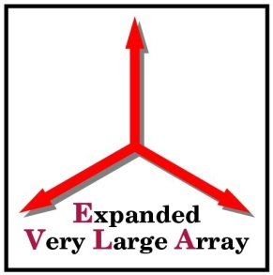






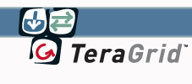












Notes:
7
Here are some examples of NSF’s sponsored large facilities. If you want me to add your logo, please send it to me.
George Strawn, NFS CIO now detailed to NCO for Networking and Information Technology R&D (NITRD) has often described our large facilities as a bunch of devices connected to computers connected to each other.
Scientists who want to “do science” suddenly find themselves worrying about, among other things, cybersecurity.

Slide 8
What is at stake…
Lost productivity
  TeraGrid
    Supports around $300M+ in research annually*
    STAKKATO Incident ca. 2003-2004
  McAfee DAT 5958
    Worldwide impact April 2010
    Not the first time this has happened
* Information provided by John Towns, NCSA
Notes:
Lost productivity
TeraGrid supports around $300M in research annually*
Incident spanned about 11 months
McAfee DAT 5958
Affected Windows XP systems with SP3 WORLDWIDE. Not tested on SP3 systems. Deleted a critical systems file that caused the systems to continuously reboot and not be able to see the network.
At NSF, it impacted….
http://www.darkreading.com/vulnerability_management/security/client/showArticle.jhtml?articleID=224600179

Slide 9
What is at stake…
Expensive incident response and notification
  Laptop stolen from public west-coast research university:
    $750K out of pocket
  Research server breach at private east-coast research university:
    $200K out of pocket
  External hard drive stolen containing student and alumni data from a locked office at research university:
    $1M out of pocket
Notes:
Incident response and notification are expensive
Laptop stolen from public west-coast research university 2005:
$750K out of pocket
Research server breach at private east-coast research university 2006:
$200K out of pocket

Slide 10
What is at stake…
Expensive incident response and notification
  Laptop Stolen from a Large Facility
    Required notifying a military partner
  McAfee 5958 at NSF
    1,800 PCs impacted; down 6-8 hours;
    lasted 2-3 days
  Cost of TeraGrid’s STAKKATO Incident in 2003-2004
    Spanned 11 months
    Not calculated
Notes:
Incident response and notification are expensive
> All XP machines at the NSF were affected, so we would estimate that > ~1800 PCs were impacted by the DAT file issue and the majority were > down for about 6 to 8 business hours; however, this carried over for > 2 to 3 days due to staff being out of the office. IT Help Central > opened close to 450 service requests related to this issue. Cost of the TeraGrid’s Stakkato Incident in 2003-2004: not calculated

Slide 11
What is at stake…
Reputational damage
  Institution or agency: can’t estimate
  PII disclosure of patient or alumni data: priceless
Data integrity compromise
  Would you know if a data element was changed?
Facilities need an awareness of security breach implications that could impact the facility, NSF or the United States of America.
Notes:
Lost productivity
TeraGrid supports around $271M in research annually*
Incident response and notification are expensive
Laptop stolen from public west-coast research university 2005:
$750K out of pocket
Research server breach at private east-coast research university 2006:
$200K out of pocket
Cost of the TeraGrid’s Stakkato Incident in 2003-2004: not calculated
Reputational damage
Hard to estimate the institutional or agency damage
PII disclosure of patient or alumni data: priceless
Data integrity compromise
Would you know if a data element was changed?

Slide 12
Data Loss Incidents by Type
Note: 49% of the incidents involved something “lost” or “stolen”.
Data as of 1/3/2011
http://www.datalossdb.org/statistics
Notes:
Looks slightly different from web as I consolidated some similar categories to make it easier to read.

Slide 13
Data Loss Incidents by Vector
1/3 are Inside
Data as of 1/3/2011

Slide 14
Data Loss by Business Type
http://www.datalossdb.org/statistics
Notes:
This is “all time” data. The site has many breakouts and is updated nightly.

Slide 15
REPORTED Data Loss

Slide 16
Dataloss by HQ Location
Notes:
Interesting to overlay this map with a map of research facilities

Slide 17
2010 Threat Predictions
By McAfee Labs
Web evolution leads to escalating attacks
  Twitter, abbreviated URLs, Web 2.0, Social Networking
Target Attacks
  Individuals, corporations, government institutions
Malware writers love Adobe, Microsoft products
Banking Trojans grow smarter as they follow the money
Botnet warfare
  “biggest thorn in the side of cybersecurity professionals”
Cybercrime: a good year for law enforcement
  International in scope
http://www.mcafee.com/us/resources/reports/rp-threat-predictions-2010.pdf

Slide 18
2010's biggest security SNAFUs
By Ellen Messmer and Tim Greene, Network World December 02, 2010
Aurora attacks on Google. Intellectual property.
China ISP takes Internet for a ride. 15% of Internet traffic rerouted through China
McAfee's oopsie. Faulty antivirus update (affected NSF)
Showtime for Cisco. Data breach
Google (wireless) sniffing. Collecting data on individuals
An iPad surprise. 100,000 customer emails exposed.
Unhealthy security. South Shore Hospital (MA) 800,000 records spanning 15 years
Spy drama. Anna Chapman in spy exchange; “incompetence rules”
Stuck with Stuxnet. Worm impacts 30,000 systems in Iran
Return of WikiLeaks. 250,000 messages of “various diplomatic correspondence”
http://www.networkworld.com/news/2010/120210-security-snafus.html?page=2

Slide 19
Targets for Emerging Threats in 2011
By McAfee Labs
Exploiting Social Media: Short-URL service abuse; Location-service abuse
Mobile: Explosion of adoption by business; a ‘hot topic’ ready to erupt
Apple: More common; more sophisticated
Applications: More ubiquity across platforms; spread of home-, work- and device controlling apps
Sophistication Mimics Legitimacy: “Signed” malware imitating legitimate files; “smart bombs” designed to trigger under certain conditions thwarting usual “combat” techniques
Botnet Survival : they continue to evolve
Hacktivism: attacks motivated by politics (eg, more Wikileak-like events)
Advanced Persistent Threats: targeted cyberespionage or cybersabotage
http://www.businesswire.com/news/home/20101228005009/en/McAfee-Labs-Predicts-Geolocation-Mobile-Devices-Apple

Slide 20
Notes:
20
Here are some examples of NSF’s sponsored large facilities. If you want me to add your logo, please send it to me.
George Strawn, NFS CIO now detailed to NCO for Networking and Information Technology R&D (NITRD) has often described our large facilities as a bunch of devices connected to computers connected to each other.
Scientists who want to “do science” suddenly find themselves worrying about, among other things, cybersecurity.

Slide 21
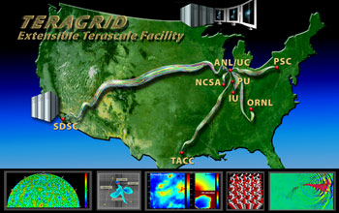
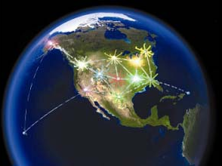
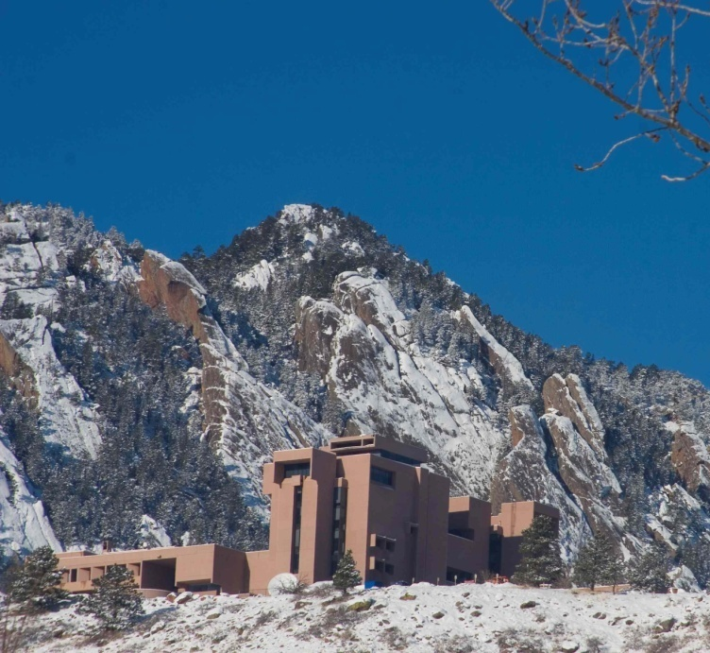

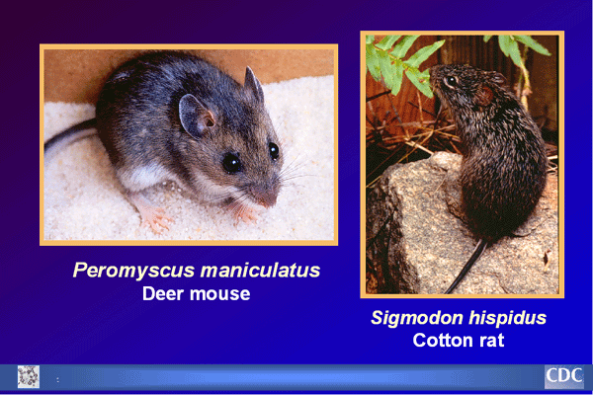

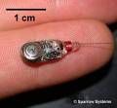
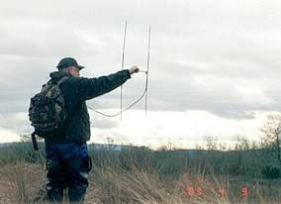
Facilities Vary: one size plan can’t fit all
Courtesy UCAR
Notes:
Large Facilities vary. George Strawn, NSF CIO, is fond of saying that more and more, large facilities are a bunch of devices and computers hooked together on a network. Some have buildings; some have multiple locations; many are comprised of sensors of many types; some are international.

Slide 22
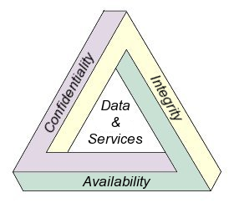
Security Fundamentals
Goal: Ensure access to services
and information
Three principles of a
Security Program:
  Confidentiality
  Integrity
  Availability
Levels of security will vary as
security goals and
requirements differ from
facility to facility
* Confidentiality, Integrity and Availability definitions taken from Wikipedia.
See: http://en.wikipedia.org/wiki/Information_security#Confidentiality.2C_integrity.2C_availability.
Site known good April 2010. Diagram is in the public domain.
Notes:
Fundamental Principles of Security are:
Confidentiality
Integrity
Availability
Confidentiality: Information that is considered to be confidential in nature must only be accessed, used, copied, or disclosed by persons who have been authorized to access, use, copy, or disclose the information, and then only when there is a genuine need to access, use, copy or disclose the information. A breach of confidentiality occurs when information that is considered to be confidential in nature has been, or may have been, accessed, used, copied, or disclosed to, or by, someone who was not authorized to have access to the information.
Integrity: In information security, integrity means that data cannot be created, changed, or deleted without authorization. It also means that data stored in one part of a database system is in agreement with other related data stored in another part of the database system (or another system). For example: a loss of integrity can occur when a database system is not properly shut down before maintenance is performed or the database server suddenly loses electrical power (see Database security). A loss of integrity occurs when an employee accidentally, or with malicious intent, deletes important data files. A loss of integrity can occur if a computer virus is released onto the computer. A loss of integrity can occur when an on-line shopper is able to change the price of the product they are purchasing.
Availability: The concept of availability means that the information, the computing systems used to process the information, and the security controls used to protect the information are all available and functioning correctly when the information is needed.

Slide 23
Information Security: First Principles
Information security is a journey not a destination.
  The challenges keep coming. Security programs evolve and improve.
Security budgets are limited
  Priorities must be established; tradeoffs must be made.
Good IT practices foster good security
  Good IT security reflects good IT practices.
Information security is more than an “IT issue.”
  It is an issue for everyone.
For managers, Information Security starts with policy.
Notes:
23
I want to start with some “first principles”.
Information security is a journey not a destination. The challenges just keep coming. Our processes evolve and improve.
Security budgets are limited. Therefore, we must establish priorities and often make tradeoffs.
Good IT practices foster good security. Good IT security reflects good IT practices. This is my new mantra.
Information Security starts with policy. That doesn’t mean you don’t wait to lock the barn door while you write the policy but that policy must form the foundation of a security program.

Slide 24
Starting with Policies
If the facility is:
…part of a larger organization, the facility should defer to the policies of its parent organization. This could be a “floor” with the facility needing to augment the policies to address specific regulations, issues or needs. It might also be a “ceiling” with the facility needing to tailor policies to its needs.
…a Consortium, the Consortium needs to have a policy that all of the members will have policies.
…not part of a Consortium and doesn’t have a parent organization, it needs to develop its own policies.
Notes:
24
This is only the first time you will hear me say to leverage the resources that are available and don’t reinvent any wheels.
If the facility is:
…part of a larger organization, the facility should defer to the policies of its parent organization. This could be a “floor” with the facility needing to augment the policies to address specific regulations, issues or needs. It might also be a “ceiling” with the facility needing to tailor policies to its needs.
…a Consortium, the Consortium needs to have a policy that all of the members will have policies.
…not part of a Consortium and doesn’t have a parent organization, it needs to develop its own policies.

Slide 25
Cybersecurity is a Balance
Open, Collaborative Environment for Research and Discovery
Confidentiality Integrity Availability
Security
Privacy
Facilities must weigh the cost of impact vs the cost of remediation.
Notes:
25
Cybersecurity is a balance. On the one hand, we all want an open, collaborative environment for research and discovery.
On the other, we need to ensure confidentiality, integrity, availability of information and resources while maintaining security and privacy.

Slide 26
Security Fundamentals
Security controls must be deployed commensurate with assessed risk.
  They are a balance between regulations and common sense.
  “Security Controls” are usually thought of as “administrative, technical (or logical) and physical”
Security and Privacy must be considered together.
  Security and Privacy
  Privacy and Security
Notes:
Fundamental Principles of Security are:
Confidentiality
Integrity
Availability
Security controls must be deployed commensurate with assessed risk, balancing between regulations and common sense. Usually, we talk about administrative, technical and physical controls.
Security and Privacy must be considered together
Security and Privacy:Privacy and Security
There is a balance between regulations and common sense.

Slide 27
Facility Cybersecurity:
Do What Makes Sense and is Appropriate
for Identified Risks
Appropriate
PPPs
for the Facility
Notes:
Where policies about cybersecurity are concerned, and I’ll say more about policies later, leverage what makes sense for your facility. If you are part of a larger institution or a consortium, balance what they have and use against NIST and other Federal or International guidance.
Create an environment that is appropriate for your facility.

Slide 28
Information Security is a Continuous Process
Execute
Security Assessments
Risk – Threats
Privacy
Security Test & Evaluation
Compliance
Managed Security Services
Intrusion Detection
Firewall Management
Incident Reporting
Vulnerability Management
Penetration Testing
Assess
Security is a continuous process of evaluation
and monitoring
Implement
Product Selection
Product Implementation
Top-down Security
Management
Plan
Risk-based Strategy
Business Continuity
Solution Planning
Resource Allocation
Design
Policy
Standards
Enterprise Architecture
Configuration Standards
Notes:
28
Information Security is a continuous process. I’m not going to speak to this slide in detail, but want to note how many of the elements I’m about to talk about interrelate. It’s important in a security program to:
Assess
Plan
Design
Implement
Execute
And then ensure you have a feedback loop for continuous improvement.
Several who previewed these slides drew the analog to safety management systems.
With this background, I will now segue into some Best Practices you may find useful.

Slide 29
Security Fundamentals
Goals
  Prevent: an intrusion or incident
  Defend: if prevention fails
  Respond: if defense fails

Slide 30
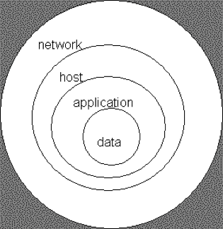
Principle of Defense in Depth
There are multiple safeguards in place so that if one fails, another will continue to provide protection.
*Public domain document from http://en.wikipedia.org/wiki/Information_security.
Site known good April 2010.
Simple DiD Model*
Notes:
30
At home, if the latch fails, there is the deadbolt. Some people add a chain on the door. Others have alarm systems. Some get a dog. All work together to keep the house and its people safe.
This building up, layering on and overlapping security measures is know as defense in depth. Just like chains, the strength of any system is no greater than its weakest link. With a defense in depth strategy, if one defensive measure fails there are other measures in place that continue to provide protection.
Using more than one of the following layers constitutes Defense in Depth.
Physical Security (e.g. dead bolt locks)
Authentication and password security
Antivirus software
Firewalls (hardware or software)
DMZ (Demilitarized zones)
IDS (Intrusion Detection Software)
Packet filters
Routers and Switches
Proxy servers
VPN (Virtual private networks)
Logging and Auditing
Biometrics
Timed access control

Slide 31
Use the Language of the Cooperative Agreement as a Framework for a Security Plan

Slide 32
NSF Cooperative Agreements
Information Security Requirement
Incorporated in NSF’s Supplemental Financial and Administrative Terms and Conditions:
  CA-FATC – Large Facilities: Article 51
  CA-FATC – FFRDCs: Article 54
Purpose is to help ensure that NSF large facilities and FFRDCs have policies, procedures and practices to protect research and education activities in support of the award.
Influenced by recommendations from awardees at previous NSF-sponsored Cyber-security summits.
Notes:
32
NSF’s Cooperative Agreements for about the last year have incorporated an information security requirement in the Supplemental Financial and Administrative Terms and Conditions.
The purpose is to help ensure that NSF large facilities and FFRDCs have policies, procedures and practices to protect research and education activities in support of the award.
The language in the CA was influenced by recommendations from awardees at previous NSF-sponsored Cyber-security summits.
In summary, it says….

Slide 33
Information Security Responsibilities
Security for all IT systems is the Awardee’s responsibility.
  Includes equipment, data and information
Awardee is required to provide a summary of its IT Security program, including:
  Roles and responsibilities, risk assessment, technical safeguards, administrative safeguards; physical safeguards; policies and procedures; awareness and training; notification procedures.
  Evaluation criteria employed to assess the success of the program
All subawardees, subcontractors, researchers and others with access to the awardee’s systems and facilities shall have appropriate security measures in place.
Awardee will participate in ongoing dialog with NSF and others to promote awareness and sharing of best practices.
Notes:
33
Security for all IT systems under the award, including equipment and information, is the Awardee’s responsibility.
The Awardee is required to provide a summary of its IT Security program:
Include roles and responsibilities, risk assessment, technical safeguards, administrative safeguards; physical safeguards; policies and procedures; awareness and training; notification procedures.
Include evaluation criteria employed to assess the success of the program
All subawardees, subcontractors, researchers and others with access to the awardee’s systems and facilities shall have appropriate security measures in place.
Awardee will participate in ongoing dialog with NSF and others to promote awareness and sharing of best practices.

Slide 34
Awardee Responsibilities under the Cooperative Agreement
Summary of
IT Security Program
Roles and
Responsibilities
Risk
Assessment
roles and responsibilities
risk assessment
technical safeguards
administrative safeguards
physical safeguards
policies and procedures
awareness and training
notification procedures
Notification
Procedures
Administrative
Safeguards
Awareness
and
Training
Technical
Safeguards
Policies
and
Procedures
Physical
Safeguards
Notes:
34
The Cooperative Agreement asks facility managers to summarize elements of their security programs to include:
roles and responsibilities
risk assessment
technical safeguards
administrative safeguards
physical safeguards
policies and procedures
awareness and training
notification procedures
I’ve represented these components in a wagon wheel (seems appropriate for “the West”).

Slide 35
IT Security Program…
Roles and
Responsibilities
Risk
Assessment
Elements of an
IT Security Program
Notification
Procedures
Administrative
Safeguards
Good planning
Sound operations
Continuous assessment
Operations
Planning
Oversight
Good Management or Oversight
Awareness
and
Training
Assessment
Technical
Safeguards
Policies
and
Procedures
Physical
Safeguards
…becomes a
Security Plan
Notes:
Now, we’ve covered all the parts of what the cooperative agreement requires. If you consider your IT planning, with your operations and build in some type of assessment or continuous improvement process, with good management oversight… you have the elements of a good IT security program.

Slide 36
Best Practices that Might Be Useful to NSF Large Facilities*
Addresses CA language
References readily available resources such as NIST,SANS, ISO, EDUCAUSE/Internet2…
Encourages collaboration and information sharing among facilities
Describes elements of a security program/plan
* http://tinyurl.com/yauxcvv

Slide 37
Issues Gaining Prominence

Slide 38
Identity and Access Management
Facilities need to establish solutions to:
  Identify a person, program or computer
  Authenticate or verify that the person, program or computer is who she/he/it claims to be
  Authorize what resources they are permitted to access and what actions they will be allowed to perform
Notes:
Current practices include X509 standards around public key infrastructure (PKI), Kerberos, etc.
More and more we’re seeing the emergence of campus-based Id providers and scalable credential providers.
LIGO is a leader in this area.

Slide 39
What is identity management?
Organization: The policies, processes, and tools used to “assure” that IT systems and applications are made available only to appropriate persons
Individual: The persons I am working with and the systems I am using really are who/what they say they are. And no one can impersonate me, or read or change my information
Identity Management has greatly increased in importance as IT systems and applications are used to perform more and more of the work of society and commerce

Slide 40
What problems are we trying to solve?
Reduce the need for multiple usernames and passwords
Reduce amount of personal data held by third parties
Reduce the duplication of effort across multiple institutions
Enable publishers, service and network providers to have a common interface for multiple systems
Ease the difficulty in sharing resources between institutions and organizations
Enable citizens to access government services
Notes:
40

Slide 41
What is federated identity?
“Federated identity management allows users to log in using their local authentication credentials (username and password assigned by their institution) to access electronic resources hosted at other institutions belonging to the same identity federation.” www.incommonfederation.org
Federated identity is designed to address:
  Multiple passwords required for multiple applications
  Scaling the account management of multiple applications
  Security issues associated with accessing third-party services
  Privacy
  Interoperability within and across organizational boundaries

Slide 42


InCommon
“InCommon eliminates the need for researchers, students, and educators to maintain multiple, passwords and usernames. Identity providers manage the levels of their users' privacy and information exchange. InCommon uses SAML-based authentication and authorization systems (such as Shibboleth®) to enable scalable, trusted collaborations among its community of participants.”
InCommon Federation www.incommonfederation.org
  Mission: create and support a
  common framework for trustworthy
  shared management of access to
  on-line resources in support of
  education and research in the US
US Research and Education Federation
  Separate entity with its own governance
  Operations managed by Internet2
  Members are degree granting accredited
  organizations and their partners
    186 universities and colleges are members as of 1/1/2011

Slide 43
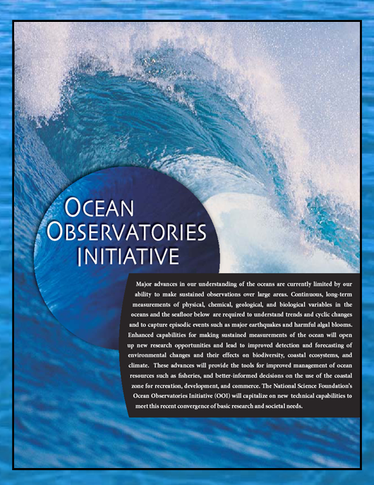
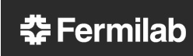

Large Research Facilities are Already Joining InCommon
  TeraGrid
Ocean
Observatories
Initiative
Fermi National Accelerator Laboratory
Argonne
National
Laboratory
Lawrence Berkeley National Laboratory
Considering InCommon membership:
Laser Interferometer Gravitational-Wave Observatory (LIGO)
Long Term Ecological Research (LTER)
National Ecological Observatory Network (NEON)
Open Science Grid (OSG)
1/4/2011

Slide 44

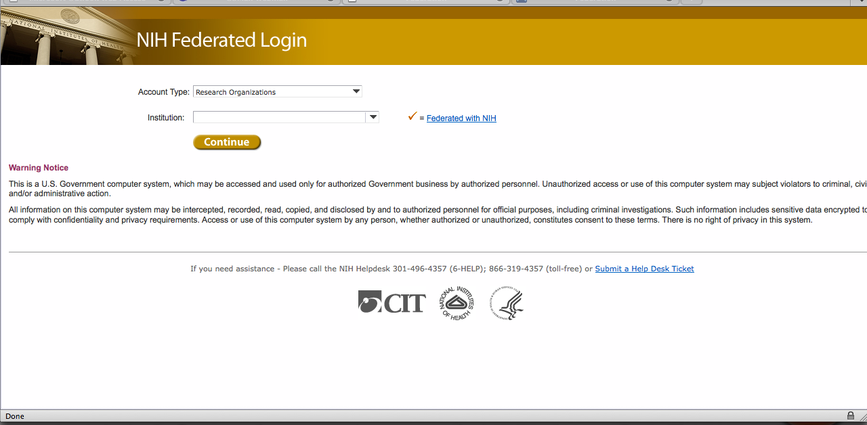
National Institutes of Health
Notes:
44

Slide 45
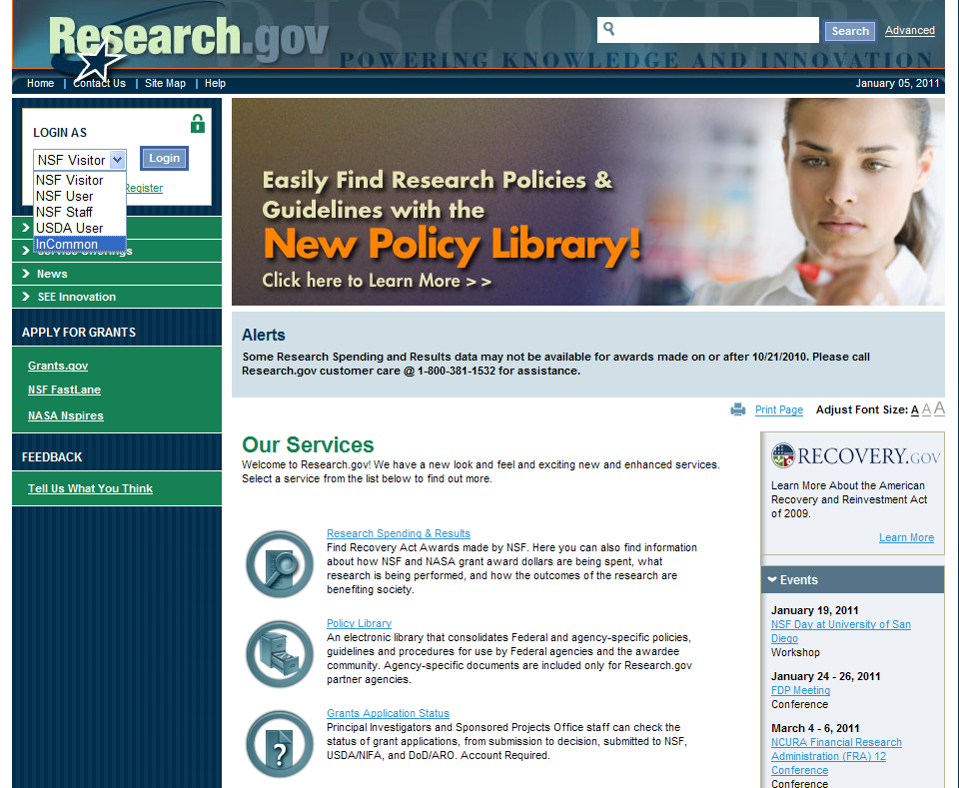
Example of Research.gov access at NSF when Federation is fully implemented
User selects login path

Slide 46
Compliance and Legal Issues
Know and understand the federal and state laws under which the facility (and institution) must operate. For example:
Regulatory Compliance
  Environmental Health and Safety
  DOE/DOD
Export Control regulations
  US Department of Commerce, State Department and Treasury
Privacy Laws/State Breach Notification Laws
  If you don’t need personally-identifiable information, don’t ask for it, don’t keep it.
HIPAA (Health Insurance Portability and Accountability Act)
  Health
FERPA (Family Educational Rights and Privacy Act)
  Student information
GLBA (Gramm-Leach-Bliley Act)
  Privacy and security of financial information
Sarbanes-Oxley Act of 2002 (SOX).
  Financial controls: could be extended to non-profits
Notes:
46
When I started in IT, life was a lot simpler. Now, even IT people have to worry about compliance an legal issues. This can be a whole lot simpler for you if you have a “parent organization.”
-The topics that potentially hit large facilities are the regulatory compliance, export controls and privacy laws.
-I’m aware of a medical research institution that almost had its research shut down when the old server for their radiation safety data on it died.
-With privacy laws, currently, 38 states have them. If you disclose personally-identifiable information in Indiana, for example, you have one week to notify people that their private information has been disclosed. My EDUCAUSE colleagues and peers believe a Federal privacy law is coming.
-Blue Waters will initially have restrictions on use. Oak Ridge required an Iranian post-doc to get “special dispensation” form Department of Commerce to use their facilities.

Slide 47
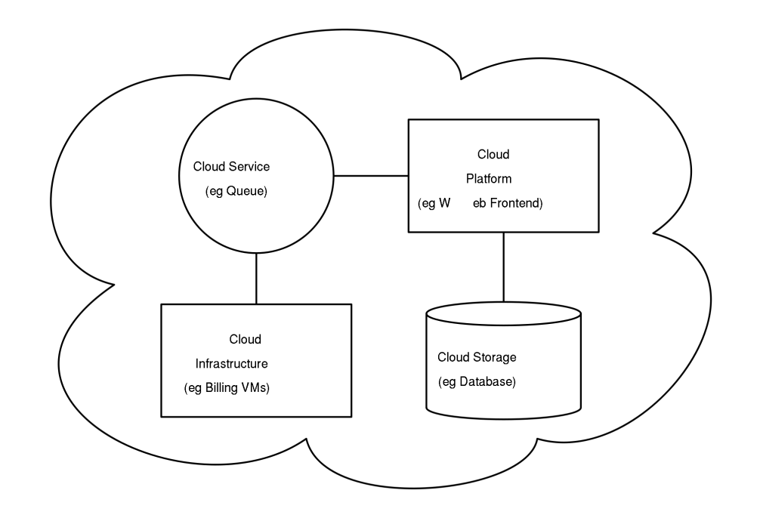
Cloud Computing
How do you:
decide which kinds of data to store in the cloud?
stay compliant with government regulations?
maintain control and protect your data?
Where in the world is your data stored?
How and where is it backed up?
What happens to your data if the “cloud company” goes out of business?
Notes:
Software as a Service
Infrastructure as a Service

Slide 48

NSF’s Data Policy
Raises security issues around:
  Archiving
  Preservation and access
  Data Integrity
One model
  If storage for a GB of data costs $X initially, $2X will store it in perpetuity
Serge Goldstein and Mark Ratliff, authors of DataSpace: A Funding and Operational Model for Long-Term Preservation and Sharing of Research Data - August 2010
Notes:
Experience teaches, it may be $3X or $4X but this is a good start on solving a problem

Slide 49
Notifying NSF

Slide 50
Notification Procedures
Understand the impact and ramifications of an incident or breach
Ensure that everyone knows their roles and responsibilities, for example:
  If you are a systems administrator, what do the IT security people need and want to know and when?
  If you are the IT security person, what does management want to know and when?
Develop procedures about notifications before an incident or breach occurs.
EDUCAUSE/Internet2 Cybersecurity Initiative Wiki has a great Data Incident Notification Toolkit*
* Site known good April 2010.
Notes:
I’m a believer in an “ounce of prevention.” Having been through not one but two incidents (one a hacked research server and the other a hard drive stolen from a locked office), it’s not fun. It’s best to think about what you will do “If” and be prepared for “when.” The EDUCAUSE/Internet2 Wiki has an excellent Data Incident Notification Toolkit available for use. I hope you never need it.
Meanwhile, ahead of time, understand the impact and ramifications of an incident or breach; ensure that everyone knows their roles and responsibilities, for example:
If you are a systems administrator, what do the IT security people need to know and when?
If you are the IT security person, what does management want to know and when?
And, develop procedures about notifications before an incident or breach occurs. EDUCAUSE/Internet2 Security Task Force has a great tool kit.

Slide 51
Examples Notification Procedures
Internal to the facility
External to the facility
  Parent organization (if one exists)
  Comparable facilities, especially if connected to the affected facility
Law enforcement
NSF (and other agencies)
Users/customers
TeraGrid has procedures and processes
that could be used as a model.
Notes:
Some examples of where you may need procedures include

Slide 52
Whether to report to NSF…
Work with your Program Officer to decide
Depends on the type or nature of the event
Considerations
  Email down: No
  Device stolen: Yes, if not encrypted and depending on content
  Data integrity is compromised: Yes
  Egregious behavior or inappropriate use: Maybe
  Cross-site incidents: Yes
  Compromise: Yes
Notes:
52
Deciding to report to NSF will depend on the nature of the event. Honestly, your program officer may not want to know your email is down. But if you have a STAKKATO-sized incident brewing, she definitely needs to know.

Slide 53
When to report to NSF…
If…
US CERT (Computer Emergency Response Team) is notified
Other facilities are involved
Other agencies are being notified
Law enforcement is involved
Or, if there is
Risk of adverse publicity or press is/will be aware
Reputational risk to the facility or its parent organization (if one exists)
Reputational risk to the National Science Foundation
…
Notes:
53
The question I always ask myself when events such as a security breach arise is, “Would I want to read this on the front page of the Washington Post or the New York Times?” I call it the “Washington Post test.”
Certainly, NSF wants to know if:
US CERT (Computer Emergency Response Team) is notified
Other facilities are involved
Other agencies are being notified
Law enforcement is involved
Risk of adverse publicity or press is/will be aware
Reputational risk to the facility or its parent organization (if one exists)
Reputational risk to the National Science Foundation

Slide 54
Who to contact at NSF…
Define a priori with your Program Officer
Who to contact at NSF:
NSF Program Officer(s)
S/he notifies NSF Division Director
  Discuss with NSF’s FACSEC Working Group for guidance on further escalation
As Appropriate…
NSF Division Director notifies NSF Assistant Director
NSF Assistant Director notifies Deputy Director who notifies the Director
…
Notes:
54
Your notification procedures should be defined before the fact with your Program Officer.

Slide 55
How to report to NSF…
Define a priori with your Program Officer
Who will be contacting the Program Officer
Some will want to hear from the PI
Others may want to hear from the cyber-security officer
Establish a secure mechanism for communication
If your computer, systems or network is compromised, don’t sent email from it! (Duh!)
Use encrypted email
Telephone
FAX
Notes:
55
How you report to NSF should be worked out with your program officer.
By all means, know how you are going to communicate.

Slide 56
Nuggets

Slide 57
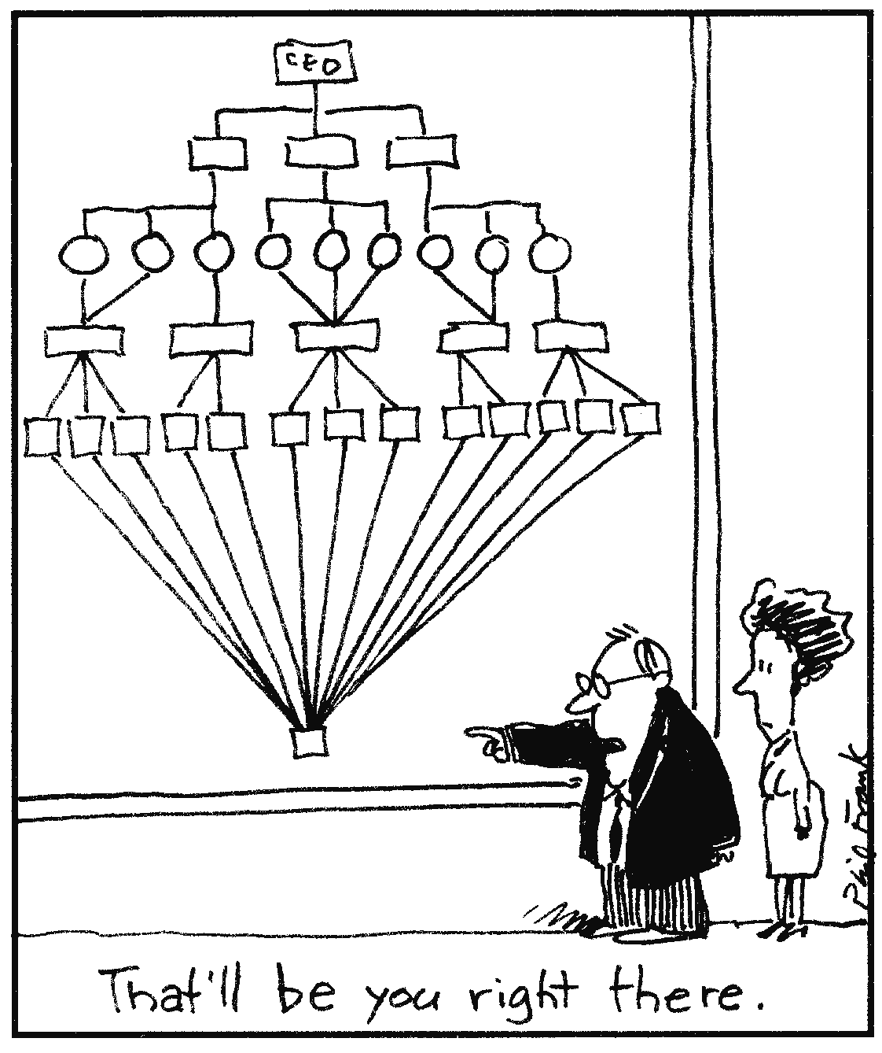
Roles and Responsibilities
Principles
One person cannot do it all
Cybersecurity is not just a technical or “computer geek” responsibility
Everyone in the facility has a responsibility for cybersecurity
Notes:
Cybersecurity is not just a technical or “computer geek” responsibility
Everyone in the facility has a responsibility for cybersecurity
Examples of identified roles include:
Upper Management
System and Network Administrators
Information Security Support Staff
Users
Internal
External

Slide 58
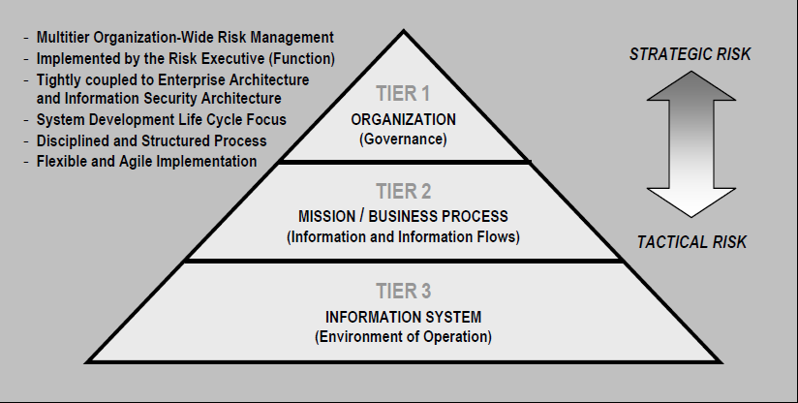
Integrated Organization-wide Risk Management
Ref: NIST 800-37 rev 1. Guide for Applying the Risk Management Framework to Federal Information Systems

Slide 59
Administrative, Technical and
Physical Safeguards (Examples; not all inclusive)
Controls are implemented to mitigate risk and reduce the potential for loss
 | Prevention | Detection | Response
Administrative | Policy and requirements | Procedures Background checks | Procedures Supervision
Technical / Logical | Passwords Authorizations Encryption | Intrusion Detection Systems Tripwire “like” Log Analysis | Recovery from backups System re-imaged
Physical | Locks Barricades | Guards Video feeds | Physical Response
Adapted from a presentation by David C. Smith, CSO, Georgetown University 2008
Notes:
This chart provides some simple, but not all inclusive, examples of appropriate responsibilities/actions as we work to protect, detect and respond to mitigate risk and reduce the potential for loss.

Slide 60
Administrative, Technical and Physical Safeguards: Important Concepts
Concept of least privilege: an individual, program or system process should not be granted any more privileges than are necessary to perform the task
Concept of separation of duties: one individual can not complete a critical task by herself
Notes:
The concept of least privilege, also known as the principle of least authority, requires that an individual, program or system process not be granted any more privileges than are necessary to perform the task. One simple example of this is that one should not use the same access account to administer a system and surf the web.
Simply put, separation of duties ensures that an individual can not complete a critical task by himself. With origins going toward preventing fraud and errors, it is an important concept not only for Information Security but IT in general.
For example: an employee who submits a request for reimbursement should not also be able to authorize payment or print the check. An applications programmer should not also be the server administrator or the database administrator - these roles and responsibilities must be separated from one another.
Both of these concepts have applicability at the administrative, technical and physical layer of security.

Slide 61
Security Awareness Training Needs to Focus on Many Levels of the Organization
Upper Management: needs to learn about the facility and institutional risks
Users: must be taught how to protect their own information, systems and portable media
Information or System “Stewards”: the PIs, researchers, managers or others are responsible for the “data”, “content” or the “process” or even the “science” but not necessarily the technology that undergirds it
Notes:
61
For example, Upper Management: needs to learn about the institutional risks
Users: must be taught how to protect their own information, systems and portable media
Information or System “Stewards”: the researchers, managers or others responsible for the “data”, “content” or the “process” or even the “science” but not necessarily the technology that undergirds it

Slide 62
Security Awareness Training Needs to Focus on Many Levels of the Organization
System and Network Administrators: require training to help them maintain and improve the security of the systems they oversee
Information Security Support Staff: all of the above as well as having a solid understanding of
  Vulnerability assessment
  Intrusion detection, incident response
  Encryption
  Authentication
All IT professionals have a professional responsibility to keep themselves current on cybersecurity
Notes:
62
System and Network Administrators: require training to help them maintain and improve the security of the systems they oversee
Information Security Support Staff: all of the above as well as having a solid understanding of
vulnerability assessment
intrusion detection, incident response
encryption
authentication

Slide 63
In summary…
Information Security is the awardee’s responsibility
Cybersecurity is not an entity unto itself but integral to complex enterprises
Notes:
Remember: your Program Director is not a cybersecurity expert

Slide 64
In summary…
Facility Security programs should be:
  Sufficient to meet the needs of the facility
  Appropriate to identified risks
Facilities should:
  Be encouraged to have good IT management practices
  Recognize Information Security is one part of good IT operations
Facilities need to recognize the roles of executives, management, technical staff, users
Notes:
Remember: your Program Director is not a cybersecurity expert

Slide 65
Don’t reinvent the wheel…
Facilities have many resources available for their use:
  Expertise and existing policies and procedures from their parent organization or institution (if they have one)
  Example security plans and programs of other Large Facilities
  Community best practices
    EDUCAUSE, Internet2, universities
  Published standards from NIST, SANS and other organizations

Slide 66
Remember…
It’s about risk mitigation
Information security programs and plans will improve over time
Information security is a journey not a destination

Slide 67
Good IT practices foster good security.
Good IT security reflects good
IT practices.

Slide 68
Questions?
Ardoth Hassler
Senior IT Advisor, NSF
ahassler@nsf.gov
Associate Vice President,
University Information Services
Georgetown University
hasslera@georgetown.edu

Slide 69
Resources/Supporting Materials

Slide 70
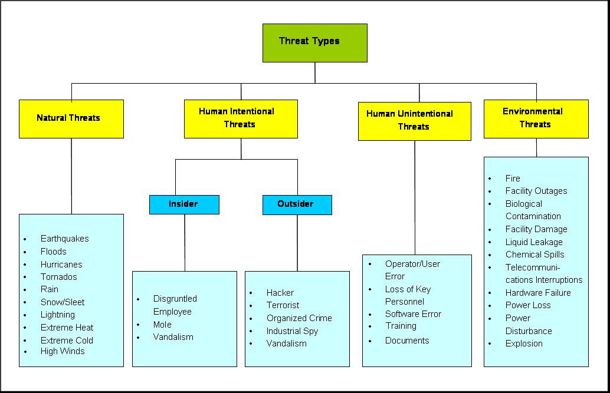
Examples of Threat Types
Ref: NIST 800-30 Risk Guide for Information Technology Systems
Notes:
70
This chart is taken from NIST 800-30 and list examples of threats that pose risks.

Slide 71
Awardee Responsibilities under the Cooperative Agreement
Summary of
IT Security Program
Roles and
Responsibilities
Risk
Assessment
roles and responsibilities
risk assessment
technical safeguards
administrative safeguards
physical safeguards
policies and procedures
awareness and training
notification procedures
Notification
Procedures
Administrative
Safeguards
Awareness
and
Training
Technical
Safeguards
Policies
and
Procedures
Physical
Safeguards
Notes:
71
The Cooperative Agreement asks facility managers to summarize elements of their security programs to include:
roles and responsibilities
risk assessment
technical safeguards
administrative safeguards
physical safeguards
policies and procedures
awareness and training
notification procedures
I’ve represented these components in a wagon wheel (seems appropriate for “the West”).

Slide 72
Roles and Responsibilities
Roles and
Responsibilities
Risk
Assessment
Notification
Procedures
Administrative
Safeguards
Awareness
and
Training
Technical
Safeguards
Policies
and
Procedures
Physical
Safeguards
Notes:
We’ll talk first about Roles and Responsibilities.

Slide 73
Roles and Responsibilities
Principles
Everyone in the facility has a responsibility for cybersecurity
Cybersecurity is not just a technical or “computer geek” responsibility
One person cannot do it all
Notes:
Cybersecurity is not just a technical or “computer geek” responsibility
Everyone in the facility has a responsibility for cybersecurity

Slide 74
Roles and Responsibilities
Examples of identified roles include:
Upper Management
System and Network Administrators
Information Security Support Staff
Users
  Internal
  External
Notes:
Everyone in the organization has a role in cybersecurity.
A few examples include:
Upper management: they need to take cybersecurity seriously and recognize it is more than an IT issue. They must support the security staff with policy approvals and funding, for example, and providing authority to the security staff to act as needed.
Systems and network administrators: must maintain their systems with current patches and updated virus protection. They must keep themselves current on the technology and security issues specific to the systems they are responsible for.
Information security professionals need breadth and depth of knowledge about cybersecurity. They also need the authority to take immediate action when needed. They in turn have a responsibility to educate and communicate with upper management and their constituents to ensure what they are doing is understood at a management level.
Users: both internal and external to a facility need to remember the old story about the chain and it’s weakest link.

Slide 75
Risk Assessment
Risk
Assessment
Roles and
Responsibilities
Notification
Procedures
Administrative
Safeguards
Awareness
and
Training
Technical
Safeguards
Policies
and
Procedures
Physical
Safeguards

Slide 76
Integrated Organization-wide Risk Management
Ref: NIST 800-37 rev 1. Guide for Applying the Risk Management Framework to Federal Information Systems

Slide 77
FISMA Risk Management Framework
Architecture Description
Architecture Reference Models
Mission and Business Processes
Information System Boundaries
Process Overview
Organizational Inputs
Laws, Policy, Guidance Priorities
Resource Availability
Step 1
Categorize
Information System
(FIPS 199)
Step 6
Monitor
Security Controls
(SP 800-37, 53A)
Step 2
Select
Security Controls
(SP 800-53)
Step 5
Authorize Information System
(SP 800-37)
Step 3
Implement
Security controls
Step 4
Assess
Security Controls
(SP 800-53A)
Ref: NIST 800-37 rev 1. Guide for Applying the Risk Management Framework to Federal Information Systems

Slide 78

A Model for Risk Assessment:
EDUCAUSE/Internet2 Higher Education Security Council
Phase 0: Establish Risk Assessment Criteria for the Identification and Prioritization of Critical Assets - Asset Classification
Phase 1: Develop Initial Security Strategies
Phase 2: Technological View - Identify Infrastructure Vulnerabilities
Phase 3: Risk Analysis - Develop Security Strategy and Plans
* Source: EDUCUASE/Internet2 Higher Education Information Security Council: Risk Assessment Framework.
Site known good April 2010.
Notes:
There are many models for assessing risk.
This first model is taken directly from the EDUCAUSE/Internet2 Security Task Force Tools. It recommends:
Establishing your risk assessment criteria
Developing your initial security strategies
Next, from the technological view, identifying your infrastructure vulnerabilities.
Finally, based on this risk analysis, developing your security strategy and plans.

Slide 79
Administrative,
Technical and Physical Safeguards
Roles and
Responsibilities
Risk
Assessment
Administrative
Safeguards
Notification
Procedures
Awareness
and
Training
Technical
Safeguards
Policies
and
Procedures
Physical
Safeguards
Notes:
As I mentioned earlier, Administrative, Technical and Physical safeguards and controls are typically taken together.

Slide 80
Administrative, Technical and
Physical Safeguards (Examples; not all inclusive)
Controls are implemented to mitigate risk and reduce the potential for loss
 | Prevention | Detection | Response
Administrative | Policy and requirements | Procedures Background checks | Procedures Supervision
Technical / Logical | Passwords Authorizations Encryption | Intrusion Detection Systems Tripwire “like” Log Analysis | Recovery from backups System re-imaged
Physical | Locks Barricades | Guards Video feeds | Physical Response
Adapted from a presentation by David C. Smith, UISO, Georgetown University 2008
Notes:
This chart provides some simple, but not all inclusive, examples of appropriate responsibilities/actions as we work to protect, detect and respond to mitigate risk and reduce the potential for loss.

Slide 81
Administrative, Technical and Physical Safeguards: Important Concepts
Concept of least privilege: an individual, program or system process should not be granted any more privileges than are necessary to perform the task
Concept of separation of duties: one individual can not complete a critical task by herself
Notes:
The concept of least privilege, also known as the principle of least authority, requires that an individual, program or system process not be granted any more privileges than are necessary to perform the task. One simple example of this is that one should not use the same access account to administer a system and surf the web.
Simply put, separation of duties ensures that an individual can not complete a critical task by himself. With origins going toward preventing fraud and errors, it is an important concept not only for Information Security but IT in general.
For example: an employee who submits a request for reimbursement should not also be able to authorize payment or print the check. An applications programmer should not also be the server administrator or the database administrator - these roles and responsibilities must be separated from one another.
Both of these concepts have applicability at the administrative, technical and physical layer of security.

Slide 82
Administrative Safeguards
Roles and
Responsibilities
Risk
Assessment
Notification
Procedures
Administrative
Safeguards
Awareness
and
Training
Technical
Safeguards
Policies
and
Procedures
Physical
Safeguards

Slide 83
Administrative Safeguards
Examples
Compliance and Legal Issues
Policies and Procedures
Awareness and Training
Risk Assessment and Management (previous section)
Continuity of operations (discussed later)
Notes:
83
When you read about and study information security, policies and procedures, awareness and training, risk assessment and management are usually considered as part of administrative responsibility. For that reason, I’m talking about there here.

Slide 84
Compliance and Legal Issues
Know and understand the federal and state laws under which the facility (and institution) must operate. For example:
Regulatory Compliance
  Environmental Health and Safety
  DOE/DOD
Export Control regulations
  US Department of Commerce, State Department and Treasury
HIPAA (Health Insurance Portability and Accountability Act)
  Health
FERPA (Family Educational Rights and Privacy Act)
  Student information
GLBA (Gramm-Leach-Bliley Act)
  Privacy and security of financial information
Sarbanes-Oxley Act of 2002 (SOX).
  Financial controls: could be extended to non-profits
Privacy Laws/State Breach Notification Laws
  If you don’t need personally-identifiable information, don’t ask for it, don’t keep it.
Notes:
84
When I started in IT, life was a lot simpler. Now, even IT people have to worry about compliance an legal issues. This can be a whole lot simpler for you if you have a “parent organization.”
-The topics that potentially hit large facilities are the regulatory compliance and privacy laws.
-I’m aware of a medical research institution that almost had its research shut down when the old server for their radiation safety data on it died.
-With privacy laws, currently, 38 states have them. If you disclose personally-identifiable information in Indiana, for example, you have one week to notify people that their private information has been disclosed. My EDUCAUSE colleagues and peers believe a Federal privacy law is coming.
Regulatory Compliance
Environmental Health and Safety
DOE/DOD
HIPAA (Health Insurance Portability and Accountability Act)
health
FERPA (Family Educational Rights and Privacy Act)
student information
GLBA (Gramm-Leach-Bliley Act)
Privacy and security of financial information
Sarbanes-Oxley Act of 2002 (SOX).
Financial controls: could be extended to non-profits
Privacy Laws/State Breach Notification Laws
If you don’t need personally-identifiable information, don’t ask for it and don’t keep it.

Slide 85
Administrative Safeguards: Policies and Procedures
Roles and
Responsibilities
Risk
Assessment
Notification
Procedures
Administrative
Safeguards
Awareness
and
Training
Technical
Safeguards
Policies
and
Procedures
Physical
Safeguards
Notes:
I started out by saying, “IT security starts with policy.” Policies are extremely important and they need to be written, communicated and understood by all to whom they apply.
That said, “they” say there are two things you never want to see made: sausage and legislation. I always add institutional policy to that, though I will say it’s easier to develop policy at NSF than it is at a university!
The good news is there are many examples of good policies and many sources. You don’t have to reinvent the policy wheel.

Slide 86
Examples of Policies
Security Policies and Procedures*
  1.0 Security Policy (This section is policy about security policy)
  2.0 Organizational Security
  3.0 Asset Classification
  4.0 Personnel Security
  5.0 Physical and Environmental Security
  6.0 Communications and Operations Management
  7.0 Access Control
  8.0 System Development and Maintenance
  9.0 Business Continuity Management
  10.0 Compliance
  11.0 Incident Management
  12.0 Security Plans
*Source: Outline taken from EDUCAUSE/Internet2 Information Security Guide.
Site known good April 2010.
Notes:
This list is taken straight from the EDUCAUSE/Internet2 Security Guide. It details areas where most organizations need policies.
Policies are typically very general and can be short but state the overall all principles that are needed. They often require approval at several levels: consensus within the community, middle and upper management. Final approval often rests with an institutions Board. Done right, a good policy will last 4-5 years.
The accompanying procedures generally get into specifics and operations. These require fewer levels of approval and are more easily changed.
Again, don’t reinvent the wheel.

Slide 87
More Example Policies
Responsible/Acceptable Use Policy (AUPs)
  Typically define what uses are permitted and what are not. (e.g., no personal commercial gain, no illegal behavior, follow export control mandates, etc.)
“Agreement of Use” or “Rules of Behavior.”
Facilities need to make sure that:
  Only authorized users are using resources and know how they are using them
  Users are accountable for the actions of others they may designate as users
  Users are aware of consequences of misuse
Facilities need an awareness of security breach implications that could impact the facility, NSF or the United States of America.
* Examples may be found on the SDSC and TeraGrid web sites.
Notes:
AUPs have been around higher-ed for a long time. I drafted my first one about 1982. The AUP is your place to define what users can and can’t do.
Agreements of use and rules of behavior are newer than AUPs. At Georgetown, we’re working on a ROB that anyone working with sensitive information will be required to sign. Both the SDSC and the TeraGrid have examples on their websites of what they expect of their users.
“Facilities need an awareness of National security implications that the President/Congress/American people would feel are a real concern.”
Scientific culture may differ from good practice.

Slide 88
More Example Policies
Laptop and Portable Device Encryption Policy
  Describe what can be stored on a laptop, thumb drive or other device
  Protect against loss of scientific information
  Protect administrative information, especially PII (personally-identifiable information)
Remember: this is facility information, not agency information.
* NB: DOD Bans Use of Thumb Drives, November 2008

Slide 89
Administrative Safeguards: Awareness and Training
Roles and
Responsibilities
Risk
Assessment
Notification
Procedures
Administrative
Safeguards
Awareness
and
Training
Technical
Safeguards
Policies
and
Procedures
Physical
Safeguards
Notes:
Security awareness training can be formal and what I call “informal” but it needs to be targeted at many levels.

Slide 90
Examples: Security Awareness Training How It Needs to Focus on Many Levels
Upper Management: needs to learn about the facility and institutional risks
Users: must be taught how to protect their own information, systems and portable media
Information or System “Stewards”: the PIs, researchers, managers or others are responsible for the “data”, “content” or the “process” or even the “science” but not necessarily the technology that undergirds it
Notes:
90
For example, Upper Management: needs to learn about the institutional risks
Users: must be taught how to protect their own information, systems and portable media
Information or System “Stewards”: the researchers, managers or others responsible for the “data”, “content” or the “process” or even the “science” but not necessarily the technology that undergirds it

Slide 91
Examples: Security Awareness Training How It Needs to Focus on Many Levels
System and Network Administrators: require training to help them maintain and improve the security of the systems they oversee
Information Security Support Staff: all of the above as well as having a solid understanding of
  Vulnerability assessment
  Intrusion detection, incident response
  Encryption
  Authentication
All IT professionals have a professional responsibility to keep themselves current on cybersecurity
Notes:
91
System and Network Administrators: require training to help them maintain and improve the security of the systems they oversee
Information Security Support Staff: all of the above as well as having a solid understanding of
vulnerability assessment
intrusion detection, incident response
encryption
authentication

Slide 92
Security Awareness Training (SAT) Resources
A Google search in the .edu domain brought up 106,000+ hits on security training!
SAT Training Materials
  Facilities should be able to utilize materials that already exist within the community
  The community could tailor training materials to the large facilities
Notes:
92
In reality, the formal training materials are probably the “easiest part” of security training. Many resources exist within the community.
Early in my career, someone told me, “Ardoth, you can’t stop water from running downhill.”
With SAT, one of our goals needs to be to keep pouring buckets down the hill. We need to leverage IT security awareness whenever we can to whomever we listen. Sometimes a “sound bite” at the right time can do wonders.
You’ll know you’ve succeeded when you hear other people say back to you what you think needs to be done.
Here are some examples of how to leverage access and why you want to.

Slide 93
Technical Safeguards
Roles and
Responsibilities
Risk
Assessment
Notification
Procedures
Administrative
Safeguards
Awareness
and
Training
Technical
Safeguards
Policies
and
Procedures
Physical
Safeguards
Notes:
With technical or logical controls or safeguards, the goals are to “prevent, detect and respond.” Colleagues could spend days talking about technical safeguards. In fact, we will at the Summit meeting next month. So, hitting some high points…

Slide 94
Technical Safeguards
Examples
Access Management and Oversight
Security Architecture
Telecommunications and Network Security
Applications and Systems Development
Business Continuity (discussed later)
Notes:
Some examples of technical responsibilities include:
Access Management and Oversight (more next slide)
Security Architecture: when you are doing project planning, systems design, facility development, consider the security architecture from the beginning.
Telecommunications and Network Security: this needs to be part of facility design.
Applications and Systems Development: security should be built in
Business Continuity (discussed later)

Slide 95
Technical Safeguards
Access Management and Oversight
Facilities need to establish solutions to:
  Identify a person, program or computer
  Authenticate or verify that the person, program or computer is who she/he/it claims to be
  Authorize what resources they are permitted to access and what actions they will be allowed to perform
Notes:
Current practices include X509 standards around public key infrastructure (PKI), Kerberos, etc.
More and more we’re seeing the emergence of campus-based Id providers and scalable credential providers.
LIGO is a leader in this area.

Slide 96
Technical Safeguards
Security Architecture &
Telecom and Network Security
Principle of Defense in Depth: There are multiple safeguards in place so that if one fails, another will continue to provide protection.
*Public domain document from http://en.wikipedia.org/wiki/Information_security.
Site known good April 2010.
Simple DiD Model*
Notes:
96
At home, if the latch fails, there is the deadbolt. Some people add a chain on the door. Others have alarm systems. Some get a dog. All work together to keep the house and its people safe.
This building up, layering on and overlapping security measures is know as defense in depth. Just like chains, the strength of any system is no greater than its weakest link. With a defense in depth strategy, if one defensive measure fails there are other measures in place that continue to provide protection.
Using more than one of the following layers constitutes Defense in Depth.
Physical Security (e.g. dead bolt locks)
Authentication and password security
Antivirus software
Firewalls (hardware or software)
DMZ (Demilitarized zones)
IDS (Intrusion Detection Software)
Packet filters
Routers and Switches
Proxy servers
VPN (Virtual private networks)
Logging and Auditing
Biometrics
Timed access control

Slide 97
Physical Safeguards
Roles and
Responsibilities
Risk
Assessment
Notification
Procedures
Administrative
Safeguards
Awareness
and
Training
Technical
Safeguards
Policies
and
Procedures
Physical
Safeguards
Notes:
Goals for physical and technical security overlap. In both, one wants operations security, appropriate IT and security practices that are relevant to operations and safeguards that are appropriate for the facility.

Slide 98
Physical
Safeguards:
Facilities Vary
Courtesy UCAR
Notes:
Large Facilities vary. George Strawn, NSF CIO, is fond of saying that more and more, large facilities are a bunch of devices and computers hooked together on a network. Some have buildings; some have multiple locations; many are comprised of sensors of many types; some are international.

Slide 99
Elements of Physical Safeguards
Examples
Administrative, Physical and Technical Controls
Facility location, construction and management
Physical security risks, threats and countermeasures
Electric power issues and countermeasures
Fire prevention, detection and suppression
Intrusion detection systems
It’s all about risk mitigation that is appropriate for the facility.
Notes:
99
We’ve talked a lot about Administrative, Physical and Technical Controls already. Other elements to consider are:
Facility location, construction and management
Physical security risks, threats and countermeasures
Electric power issues and countermeasures
Fire prevention, detection and suppression
Intrusion detection systems
It’s all about risk mitigation that is appropriate for the facility.

Slide 100
Administrative,
Technical
and Physical Safeguards (revisited)
Roles and
Responsibilities
Risk
Assessment
Notification
Procedures
Administrative
Safeguards
Awareness
and
Training
Technical
Safeguards
Policies
and
Procedures
Physical
Safeguards
Notes:
Coming back to look at the three together again, I want to talk about business continuity.

Slide 101

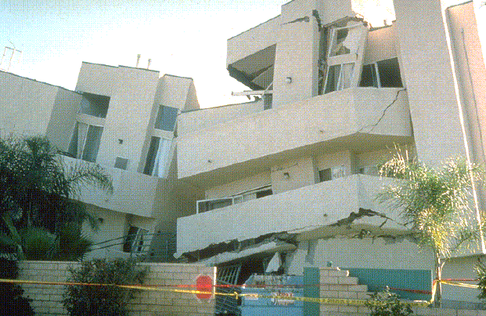
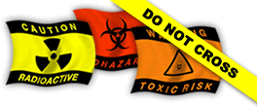
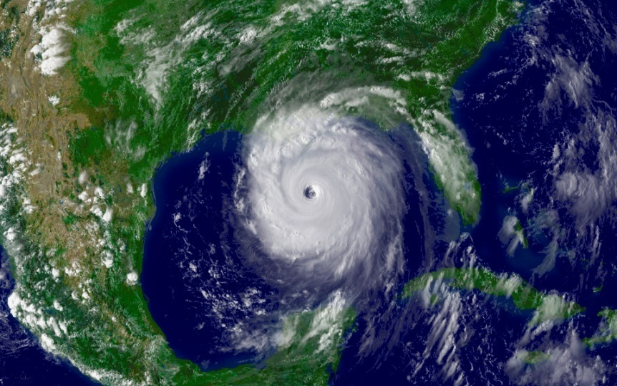
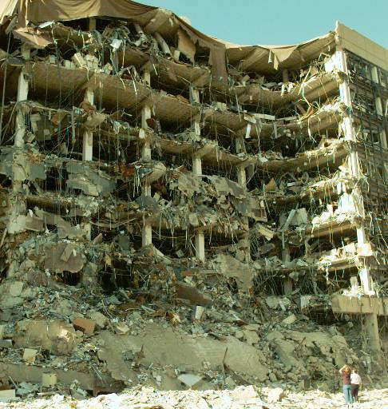
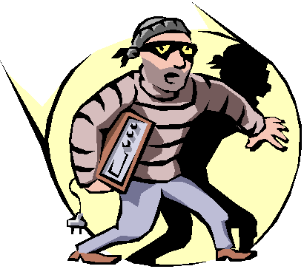
Administrative, Technical and Physical
Is it continuity of operations, disaster recovery or designing resiliency into systems OR all of the above ?
Northridge Earthquake 1994
Hurricane Katrina 2005
Oklahoma City 1995
Notes:
101
Years ago, we called it “disaster recovery planning” and we made arrangements to run the payroll offsite if our mainframe was down. Katrina and other disasters have changed how we view this.
Later, we talked about business continuity planning or continuity of operations.
Now, we talk about designing resilient systems.
Reality is, we’re preparing for many things.

Slide 102
Technical, Administrative and Physical
Continuity of Operations
Business Continuity Planning
Resilient Systems
Working with the NSF Program Director, the Facility
should determine:
What is needed when
How long a system or service can be “down”
How to ensure data integrity
Impacts
  Inside the facility
  Outside the facility
And…
Notes:
102
Work with your program officer to define…
What is needed when
How long a system or service can be “down”
How to ensure data integrity
Impacts
Inside the facility
Outside the facility
And…

Slide 103
Notification Procedures in the Event of a Breach or Security Incident
Roles and
Responsibilities
Risk
Assessment
Notification
Procedures
Administrative
Safeguards
Awareness
and
Training
Technical
Safeguards
Policies
and
Procedures
Physical
Safeguards
Notes:
Computers on any network are probed thousands of times a day. Automated processes continually look for unpatched systems and vulnerabilities. An then, there is the proverbial “kid” somewhere in the world who tries to break in for sport as well as the malicious hacker trying to steal industrial secrets or credit cards or your research. Not a day goes by that we don’t see reports of some incident in the trade press if not in the popular press.
For your notification procedures, you will need to work with your Program Officer. Please do remember that s/he is NOT a cybersecurity expert.

Slide 104
Notification Procedures
Understand the impact and ramifications of an incident or breach
Ensure that everyone knows their roles and responsibilities, for example:
  If you are a systems administrator, what do the IT security people need and want to know and when?
  If you are the IT security person, what does management want to know and when?
Develop procedures about notifications before an incident or breach occurs.
EDUCAUSE/Cybersecurity Initiative Wiki has a great Data Incident Notification Toolkit
* Site known good April 2010.
Notes:
I’m a believer in an “ounce of prevention.” Having been through not one but two incidents (one a hacked research server and the other a hard drive stolen from a locked office), it’s not fun. It’s best to think about what you will do “If” and be prepared for “when.” The EDUCAUSE/Internet2 Wiki has an excellent Data Incident Notification Toolkit available for use. I hope you never need it.
Meanwhile, ahead of time, understand the impact and ramifications of an incident or breach; ensure that everyone knows their roles and responsibilities, for example:
If you are a systems administrator, what do the IT security people need to know and when?
If you are the IT security person, what does management want to know and when?
And, develop procedures about notifications before an incident or breach occurs. EDUCAUSE/Internet2 Security Task Force has a great tool kit.

Slide 105
Examples Notification Procedures
Internal to the facility
External to the facility
  Parent organization (if one exists)
  Comparable facilities, especially if connected to the affected facility
Law enforcement
NSF (and other agencies)
Users/customers
TeraGrid has procedures and processes
that could be used as a model.
Notes:
Some examples of where you may need procedures include

Slide 106
Whether to report to NSF…
Work with your Program Officer to decide
Depends on the type or nature of the event
Considerations
  Email down: No
  Device stolen: Yes, if not encrypted and depending on content
  Data integrity is compromised: Yes
  Egregious behavior or inappropriate use: Maybe
  Cross-site incidents: Yes
  Compromise: Yes
Notes:
106
Deciding to report to NSF will depend on the nature of the event. Honestly, your program officer may not want to know your email is down. But if you have a STAKKATO-sized incident brewing, she definitely needs to know.

Slide 107
When to report to NSF…
If…
US CERT (Computer Emergency Response Team) is notified
Other facilities are involved
Other agencies are being notified
Law enforcement is involved
Or, if there is
Risk of adverse publicity or press is/will be aware
Reputational risk to the facility or its parent organization (if one exists)
Reputational risk to the National Science Foundation
…
Notes:
107
The question I always ask myself when events such as a security breach arise is, “Would I want to read this on the front page of the Washington Post or the New York Times?” I call it the “Washington Post test.”
Certainly, NSF wants to know if:
US CERT (Computer Emergency Response Team) is notified
Other facilities are involved
Other agencies are being notified
Law enforcement is involved
Risk of adverse publicity or press is/will be aware
Reputational risk to the facility or its parent organization (if one exists)
Reputational risk to the National Science Foundation

Slide 108
Who to contact at NSF…
Define a priori with your Program Officer
Who to contact at NSF:
NSF Program Officer(s)
S/he notifies NSF Division Director
  Discuss with NSF’s FACSEC Working Group for guidance on further escalation
As Appropriate…
NSF Division Director notifies NSF Assistant Director
NSF Assistant Director notifies Deputy Director who notifies the Director
…
Notes:
108
Your notification procedures should be defined before the fact with your Program Officer.

Slide 109
How to report to NSF…
Define a priori with your Program Officer
Who will be contacting the Program Officer
Some will want to hear from the PI
Others may want to hear from the cyber-security officer
Establish a secure mechanism for communication
If your computer, systems or network is compromised, don’t sent email from it! (Duh!)
Use encrypted email
Telephone
FAX
Notes:
109
How you report to NSF should be worked out with your program officer.
By all means, know how you are going to communicate.

Slide 110
IT Security Program…
Roles and
Responsibilities
Risk
Assessment
Elements of an
IT Security Program
Notification
Procedures
Administrative
Safeguards
Good planning
Sound operations
Continuous assessment
Operations
Planning
Oversight
Good Management or Oversight
Awareness
and
Training
Assessment
Technical
Safeguards
Policies
and
Procedures
Physical
Safeguards
…becomes a
Security Plan
Notes:
Now, we’ve covered all the parts of what the cooperative agreement requires. If you consider your IT planning, with your operations and build in some type of assessment or continuous improvement process, with good management oversight… you have the elements of a good IT security program.

Slide 111
Access Management and
Oversight Initiatives
Internet2 Middleware Initiatives
  Shibboleth Project
JA-SIG Central Authentication Service (CAS)
InCommon Federation
International
  UK Joint Information Systems Committee (JISC)
  Internet2 lists 18 Federations

Slide 112
References
EDUCAUSE/Internet2 Computer and Network Security Task Force Security Guide
NIST Computer Security Resource Center
The Center for Internet Security
International Standards Organization
SANS (SysAdmin, Audit, Network, Security) Institute SANS
Control Objectives for Information and related Technology (COBIT)
Wikipedia
Notes:
112

Slide 113
References
“Best Practices in Cybersecurity That Might be Useful for to NSF Large Facilities”
  TeraGrid knowledge base. See:
    https://portal.teragrid.org/kb?p_p_id=knowledgebase_WAR_knowledgebaseportlet&p_p_lifecycle=0&p_p_state=normal&p_p_mode=view&p_p_col_id=column-1&p_p_col_count=1&_knowledgebase_WAR_knowledgebaseportlet_docid=aypt#tabletop
    http://tinyurl.com/yauxcvv
  EDUCAUSE/Internet2. See:
    https://wiki.internet2.edu/confluence/display/itsg2/Home
Notes:
113

Slide 114
“Cyber Espionage Efforts By Well Resourced Organizations Looking To Extract Large Amounts
Of Data - Particularly Using Targeted Phishing”
One of the biggest security stories of 2007 was disclosure in Congressional hearings and by senior DoD officials of massive penetration of federal agencies and defense contractors and theft of terabytes of data by the Chinese and other nation states. In 2008, despite intense scrutiny, these nation-state attacks will expand; more targets and increased sophistication will mean many successes for attackers. Economic espionage will be increasingly common as nation-states use cyber theft of data to gain economic advantage in multinational deals. The attack of choice involves targeted spear phishing with attachments, using well-researched social engineering methods to make the victim believe that an attachment comes from a trusted source, and using [then] newly discovered Microsoft Office vulnerabilities and hiding techniques to circumvent virus checking.
Top Ten Cyber Security Menaces for 2008,
SANS Institute. http://www.sans.org/2008menaces/

Slide 115
Photos and Graphics Courtesy:
EDUCAUSE and Internet2
NSF and the Large Facilities
Datalossdb Open Security Foundation
Wikipedia (public domain or permission to use)
Oklahoma City: oklahomacitybombing.com
US Department of Commerce

Slide 116
A word about Wikipedia…
CNET says about Wikipedia*:
“The good: Wikipedia is free and easy to access; full of arcane information; evolving constantly; multiple languages; enormous collection of articles and media; works in any browser.
“The bad: Vulnerable to vandalism; some Wikipedia sections still under construction; lack of kids' resources; uninspiring interface; demands Web access for most recent content.
“The bottom line: Wikipedia offers rich, frequently updated information online, but you might need to verify some of its facts.”
For IT security, definitions are consistent with other sources and their reference links are to sources IT professionals would expect to find and use.
* CNET Network: http://reviews.cnet.com/general-reference/wikipedia/4505-3642_7-31563879.html.
Site known good March 25, 2009
Notes:
People tend to either love Wikipedia or deride it.
Librarians say:
“Wikipedia is not authoritative
Wikipedia should not be cited in academic work
Librarians should contribute their skills to Wikipedia
Wikipedia is rough amalgamation of several kinds of specialist encyclopedias”
I’ve used it here because for security, it’s pretty good when you read similar material in other sources.
It’s readily available. Easy to attribute.
Some of the material is in the public domain.
I have avoided using proprietary material.
Cnet.com is an online source of technology news, products, reviews, resources, etc. See www.cnet.com

Slide 117
This is a little story about four people named Everybody, Somebody, Anybody, and Nobody.
There was an important job to be done and Everybody was sure that Somebody would do it.
Anybody could have done it, but Nobody did it.
Somebody got angry about that because it was Everybody's job.
Everybody thought that Anybody could do it, but Nobody realized that Everybody wouldn't do it.
It ended up that Everybody blamed Somebody when Nobody did what Anybody could have done
* Poster from US
Department of Commerce

