Slide 1
Password Adventures for a VO
Warren G Anderson
LIGO Identity and Access Management

Slide 2
LIGO

Slide 3
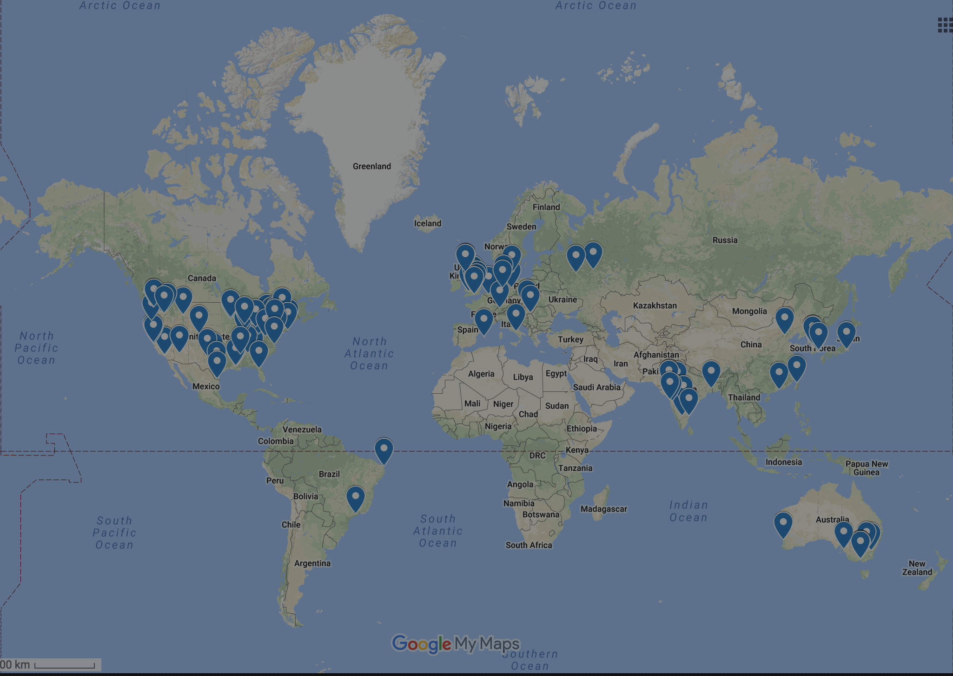
LIGO
The LIGO Scientific Collaboration is comprised of over 1700 scientists from 105 institutions in 22 nations on five continents.

Slide 4
Authentication
LIGO scientists need access to:
More than 125 Shibboleth service providers (wikis, e-logbooks, etc)
Five LIGO Data Grid computing clusters
Instrument control systems and other sensitive applications.
All AuthN backed by LIGO.ORG kerberos realm.

Slide 5
Password Management
Passwords created when user joins LIGO, expired when user leaves.
First passwords issued over a decade ago.
No password quality checking on first passwords, limited checking implemented after a few years.
No password expiry policy.

Slide 6
Password Change
Global password change requirement motivated by two security concerns:
Bring all passwords into compliance with password policy.
Remove deprecated enctypes from KDC.

Slide 7
Auxiliary Benefits
During password change, users asked to agree to two new policies:
LIGO.ORG credential acceptable use policy, which is required for SIRTFI compliance of LIGO Shibboleth IdP
LIGO.ORG personal information policy for EU GDPR.

Slide 8
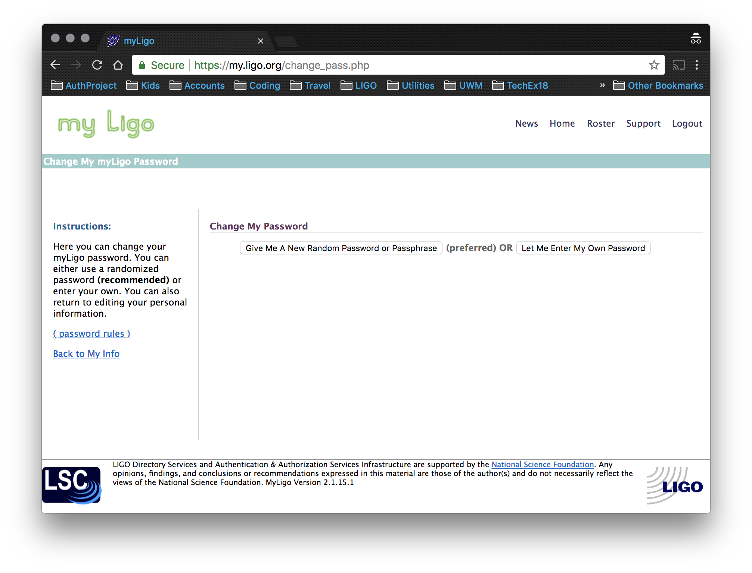

Slide 9
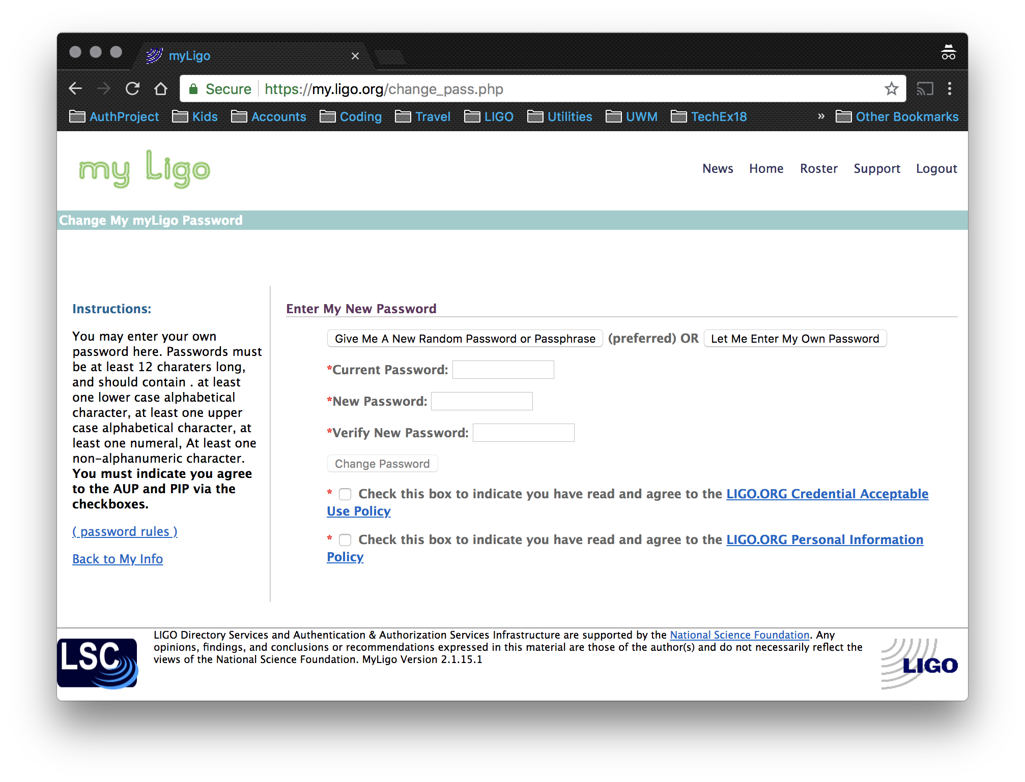

Slide 10
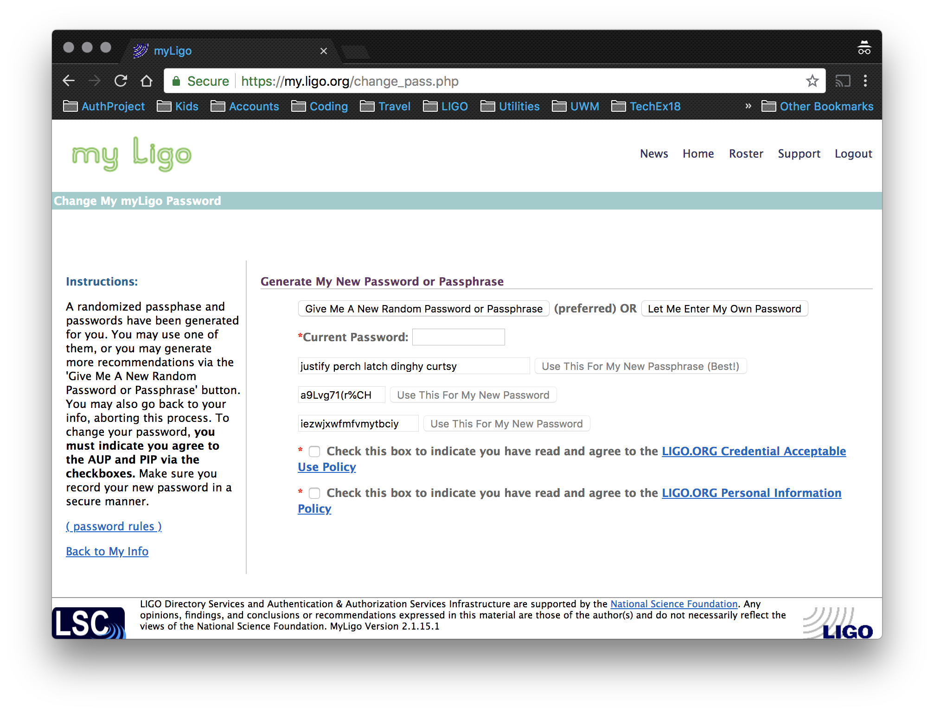

Slide 11
Process
Users given two weeks to change their passwords.
Users who had not changed their password within two weeks were locked out until they changed their password.
4 Reminder emails (on an escalating schedule) sent to remind users.

Slide 12
Results
Five days before deadline over 1600 of 1721 (94%) of passwords unchanged.
Users had had over a week to comply.

Slide 13
Results
One day before deadline over 500 of 1721 (29%) of passwords unchanged.

Slide 14
Results
One day after deadline, over 392 of 1721 (23%) of passwords unchanged.

Slide 15
Results
More that one month after deadline (July 14) 203 of 1721 (12%) of passwords unchanged.

Slide 16
Political Fallout
We expected the personal information policy, which gives very little privacy protection, to be a problem, but no one commented on it at all.

Slide 17
Political Fallout
However, the credential acceptable use policy was another matter :
Several objections were raised to the clause stating that the LIGO leadership and their designees could ” limit or revoke the use of any credential at any time and for any reason it deems appropriate.”

Slide 18
Political Fallout
Debated in LIGO public forums.
Called a “violation” of basic user rights, harsh, unsanctioned.
Calls made to have it overturned by the LIGO Scientific Collaboration Council.
At least one user refused to change password because of it.

Slide 19
Political Fallout
Counter arguments were:
This was always the defacto policy, it was just written down now.
Credentials grant access to extremely expensive and sensitive equipment, we can’t be hamstrung by having to justify revocation.

Slide 20
Political Fallout
In the end, the policy was reworded to be more vague, while still giving management and security the ability to revoke credentials without a lengthy process or prior approval.

Slide 21
Other Gripes
”My password already complies with the password policy, why can’t I keep it?”
“I don’t like to have spaces in my passphrases.”
“How come the randomly generated passwords don’t have to comply with the same policy as the user generated ones?”

Slide 22
Take-Away Messages
Anecdotally, users used and liked randomly generated passwords (we did not gather statistics, unfortunately).
LIGO scientists did not seem to care much about their privacy, but they cared a lot about their “right to access”.
There is a non-negligible fraction of users in LIGO that don’t log into anything – what do they do?

